Slide 1

Bronson Healthcare group rpa Program
Presenters:
Shan Tyagi, IT
Neil Kolberg, Revenue Cycle

Slide 2
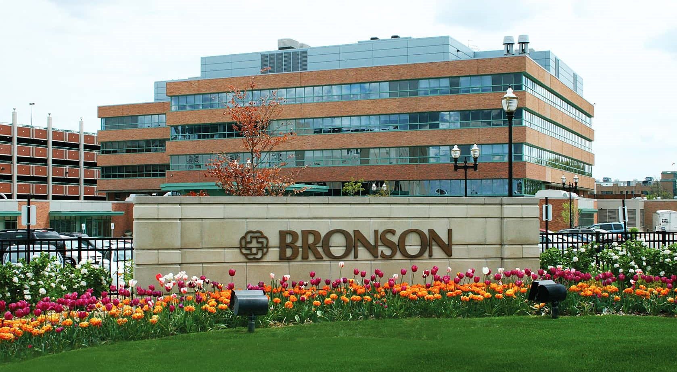
4 Inpatient facilities:
Bronson Battle Creek
Bronson Lakeview
Bronson Methodist
Bronson South Haven
~750 total IP beds
~60 Ambulatory clinics
14 Community Connect partners

Slide 3
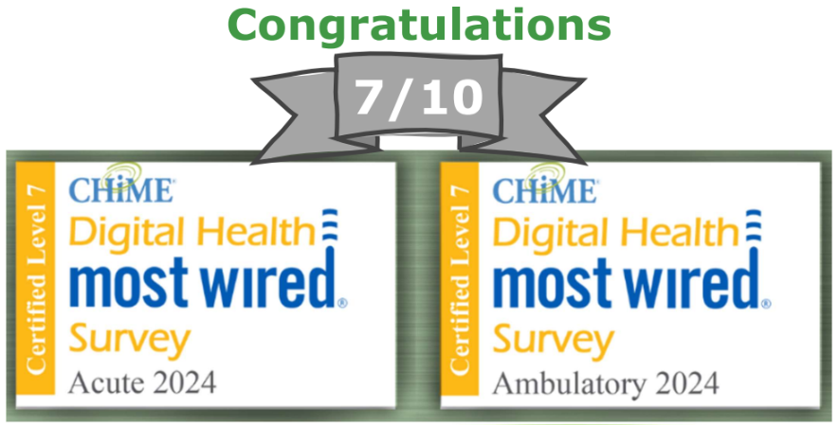
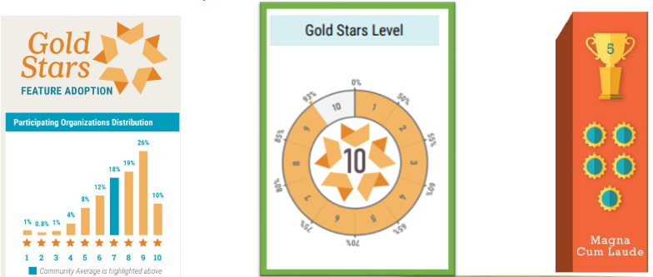
EMR vendor: Epic
RPA vendor: UiPath

Slide 4
2022 – 2024
Revenue Cycle hired a vendor to develop and support automations
IT started researching RPA
2024
Revenue Cycle leaders decided to transition to in-house RPA
IT and RC worked together to develop and build Bronson’s COE
Pilot automations determined and launched
2025+
Convert vendor-owned processes to be hosted internally
Incorporate new Federated teams into the COE
Exponential growth of active automations
Areas with active automations:
Finance
IT
Patient Access
Patient Accounting
Active automations:
27 total active automations
  24 vendor-owned
  3 in-house automations

Slide 5
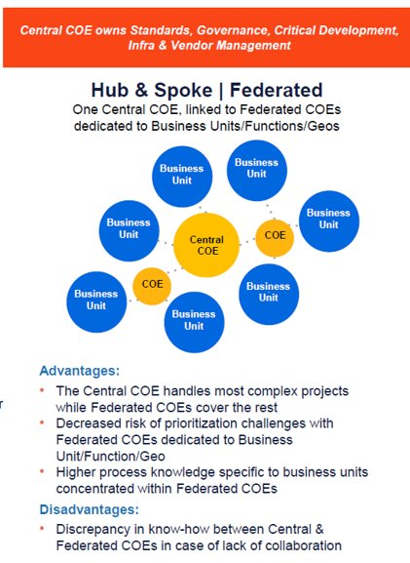
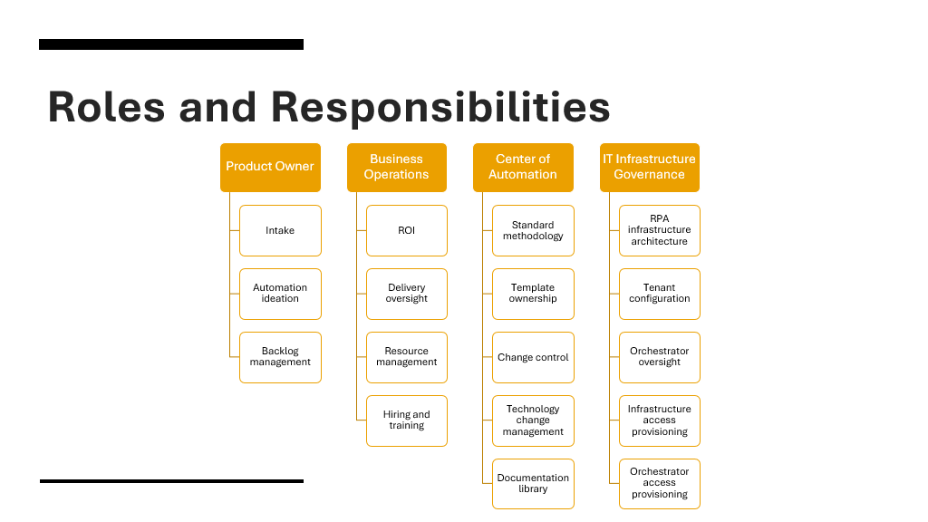

Slide 6


Slide 7

Future plans
Incorporate AI with RPA
Expand UiPath license?
Robust reporting

Slide 8


Slide 9


