Slide 1



Prior Auth API
Automation Exchange
Notes:
Intro

Slide 2

We went live in June 2023, FY2023
Our department is Revenue Cycle > Informatics
Director - Daniel Moore
Business Analyst - Isla Altamirano
Developers - Antjuan Foster, Donovin Moore, Divya Raju
“Our main focus is to build and maintain automation solutions that streamline processes, eliminate human error, and efficiency across Methodist.”
Notes:
When we started, the team, the department, and our focus.

Slide 3



Business Problems
- Authorization Delays
Patient Care
Human Error
Increase Productivity
Reduce Costs
Why API?
It's a faster solution for extracting data without the difficulty of selectors, targets, anchors, and other web elements. APIs provide a more consistent and efficient method for data retrieval.
Notes:
The business problem, why we chose API instead of RPA.

Slide 4

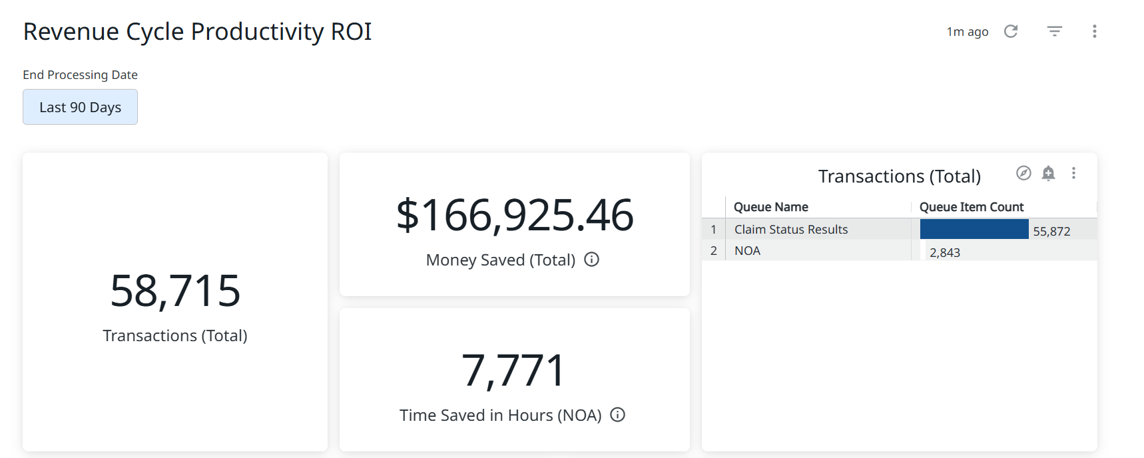
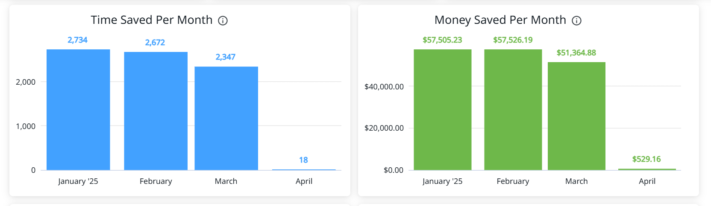
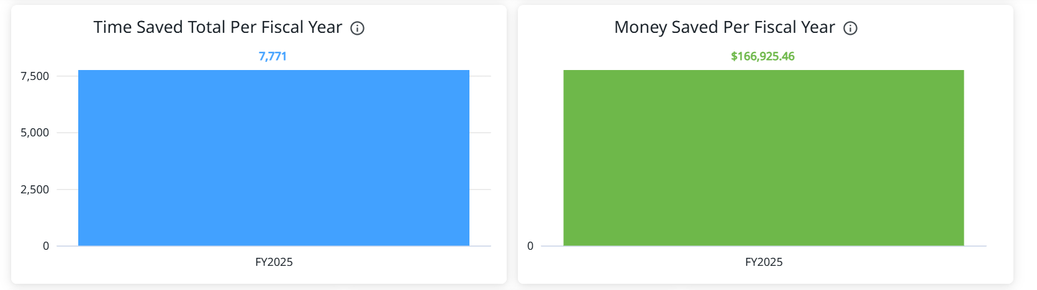
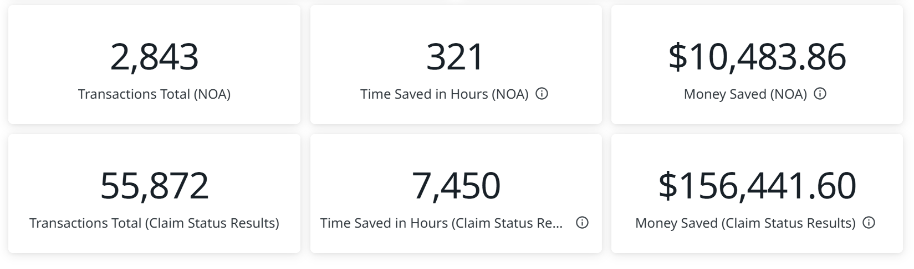
Notes:
Insights – How it benefits our program

Slide 5


What We’re Building
Automation Process for Prior Authorization:
Log into Epic.
Select the appropriate WQ.
Export data to a data table.
Import data table into Orchestrator Queue.
Check the payer’s website using queue info to see if the patient is authorized.
If prior auth is required:
The API checks UHC database for prior auth number.
Enters the info into Epic.
If prior auth is required but has no auth number, it updates patient account with status: "Auth required – review needed“
If prior auth is not required:
Update patient to reflect that no authorization is needed.
Notes:
What We’re Building – Brief Description

Slide 6

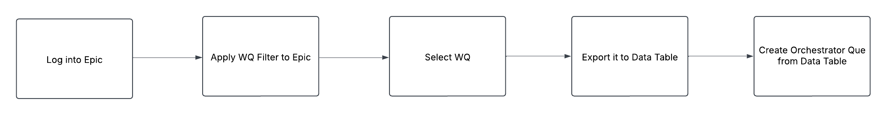
Part 1 - Extraction
To begin the process, the bot logs into Epic using the bots credentials.
Once inside the system, it applies the work queue filter to narrow down unnecessary data.
After the filter is applied, select the appropriate work queue that contains the data it needs to work with.
Once the queue is visible, it exports the data to a data table for further analysis.

Slide 7
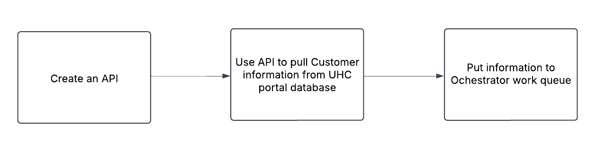
Part 2 – API to Epic
In this part of the automation we will be using an API. It will use the information from the work que extract and use it to get the Prior Auth number from UHC website in order to take the next step.
From there, the bot is determining whether or not Prior Auth is required or not and gathering reference numbers and prior auth number (if available)

Slide 8
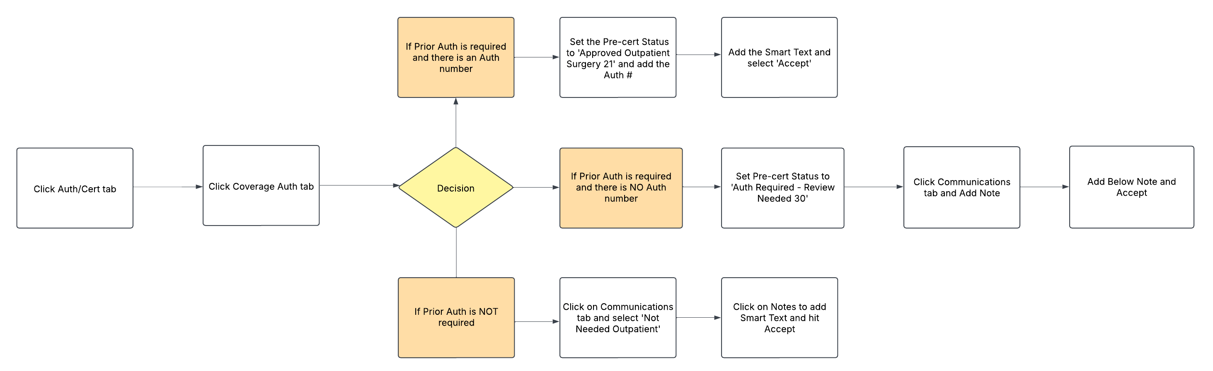
Part 3 – Epic Input
Lastly, the bot will take the information from the API queue and Orchestrator. It will use this information to work through these work queues in Epic and it will follow the above process map.

Slide 9
Open Discussion
What are some ways we can better automate this process?
If anyone has done a similar process, what are things to look for or that you’d recommend we do?
Is there a better way to improve efficiency and accuracy for this process?
Notes:
Open discussion, recommendations.

Slide 10
Thank You
For Your Time!

