Slide 1
Epic Open Encounters RPA
UW Medicine – FPPS/Technology improvements & Innovation TeaM
Automation exchange: June 5th, 2025
CONFIDENTIAL – DO NOT DISTRIBUTE

Slide 2



TECHNOLOGY IMPROVEMENTS & INNOVATION
  James Radcliffe Markus V Cruzada-Deshazer Marv Whitson
  Program Manager Program Manager Director
  Technology Improvements Office Productivity, Technology & Innovation Technology Integration & Operations Support (TIOS)

Slide 3
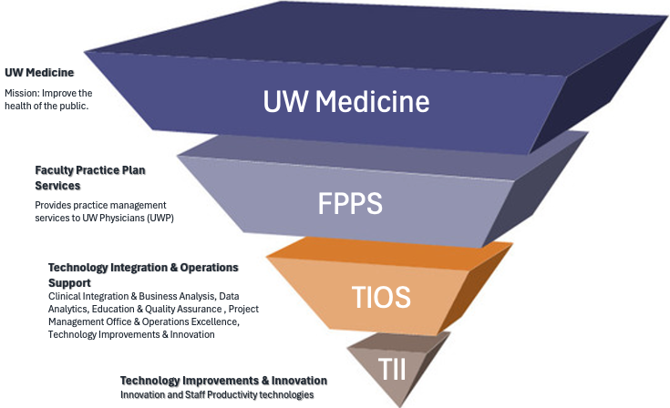
OUR TEAM
A team within the Faculty Practice Plan Business Unit of UW Medicine; one of 3 UW Medicine RPA Teams. Our focus is:
Faculty Practice Plan Operations
  Staff Productivity Tools & Applications (Office 365, SharePoint)
  Emerging and Innovative Technologies (RPA, AI)
  Technology Initiatives

Slide 4

SYSTEM AUTOMATIONS PROGRAM STRUCTURE & COE
CENTRALIZED
One Center of Excellence (CoE) serving all Business Units/Functions
Moderate Federation
Best-In-Class Partnership
Business Unit
Business Unit
Development
& Technical
Capabilities
Structure & Optimization
Environment Management
Execute
Govern
Manage
Pipeline
Staff Training
Intake Pipeline
Business Unit
Business Unit
Execute
Manage
Automation Solutions
CoE
Business Unit
Business Unit
Select
Business
Units
Automation Solutions
Business Unit
Our RPA Program sits here
Business Units
Automation Solutions
Automation Solutions - Center of Excellence:
Unified and centralized support for all Business Units
Expertise, lessons learned & best practices easier to disseminate
Standardized process
Automation Solutions + Business Units
The business can assume ownership for some execution (intake, citizen development) and some program management responsibilities.
Automation Solutions owns training, execution, governance, production and program management.
Better business outcomes, teams work together to achieve common goals

Slide 5
RPA PROGRAM ROADMAP
Q1
2023
JUL – SEP: Program Inception
SEP: Leadership Presentation
Q2
2023
Q3
2024
OCT – NOV: RPA BD Developer Pre-work & Training
NOV – DEC: DEV PoC Incubation
JAN: Full Program Rollout
FEB: RPA Ideas Intake
Q4
2024
APR: PoC DEV/PROD Focus – Epic WQ Extract
Business Analyst Program
Roadshows
2 PoC Demos:
Project Online Timesheet Submission
Epic WQ Extract
1 – Patient Financial Services
2 – Coding & Charge Capture
Q1
2024
JUL: Launch Business Analyst Program
Q2
2024
Q3
2025
OCT: Publication Epic WQ Extract
NOV – DEC: RPA Intake Reviews
JAN: RPA Intake Reviews
FEB: RPA Focus – Open Encounters Project
Q4
2025
MAR – APR: OE Automation Dev
MAY: OE Automation Go-Live
JUN: OE Automation Stabilization
Business Analyst Program
Roadshows
2 PoC Demos:
Project Online Timesheet Submission
Epic WQ Extract
2 - Finance
Notes:
Program inception to current state
Started our program in 2023 with extensive training through UiPath
Began meeting with internal leaders and teams to introduce the concept of ‘automation’
Developed our program structure and soliciting ideas from our staff
Completed our first POC with data extraction from Epic and manipulation in Excel
In 2024 we completed training for our BAs from PFS and CCC
We expanded our BAs to include members of our Finance team
In 2025 we launched our first large scale automation initiated by our President

Slide 6
RPA ROJECTS
  ID
  (PoC) FPPS 024 – Payor Relations Blue Cross/Blue Shield Work Queue Extract & Report Analysis
  STATUS
  10/01/2024: LIVE – PUBLISHED
  ID
  FPPS 030 – Open Encounters
  DESCRIPTION
  Priority Level – FPPS Automation seeks to extract Deficient Open Encounter reports from Tableau and exports them to Excel for weekly cadenced notifications to Physicians & their leadership for full reconciliation & closure.
  STATUS
  05/27/2025: LIVE – PUBLISHED
  ID
  (PoC) FPPS 025 – Project Online Timesheet Submission (POTS)
  STATUS
  Active
  ID
  FPPS 029 – EFT Reports
  STATUS
  Intake/Review
  ID
  TBD – On Call PB Analyst Daily Workflow
  STATUS
  On Hold

Slide 7
EPIC OPEN ENCOUNTERS AUTOMATION
  PROBLEM STATEMENT:
  There is currently no known process in place today for notifying providers of their open Epic encounters. Epic Dashboards and reports with this information is not utilized consistently.
    85.4% of patient encounters are completed within 3 days of service.
    13% take 4 to 30 days.
  1.6% take longer than 30 days, causing delays in posting to systems and risking millions of $$ in revenue for three clinical departments (PSY, OPHTH, UWPN) in FY23. Additionally, significant $$ are at risk due to late or missing documentation.
  GOAL STATEMENT:
  The goal of this Rapid Process Improvement is to identify root causes, implement countermeasures, reduce charges delayed beyond 31 days, accelerate cash revenue, and establish a system-wide chart closure policy, real-time dashboard, escalation path, and continuous improvement plan.
  FUTURE STATE/BUILD:
  Bot logs into Tableau and runs reports on aging encounters triggered by: DOS+7days, DOS+14days, DOS+21days, DOS +30days.
  Bot fetches data from a Facility Contact List Report and creates email notifications to update providers on open Epic encounters identified in the Tableau reporting, including clinical leaders if escalation is needed.
Notes:
Add Bot Process Map

Slide 8
CURRENT STATE (AS IS) PROCESS
No standard process existed.
Developed reports and dashboards were underutilized.
Communication to providers regarding their DTOE status was manual, infrequent and varied across the system.
Notes:
No precedence for this type of requirement
Established a workflow foundation for the proposed automation to follow

Slide 9
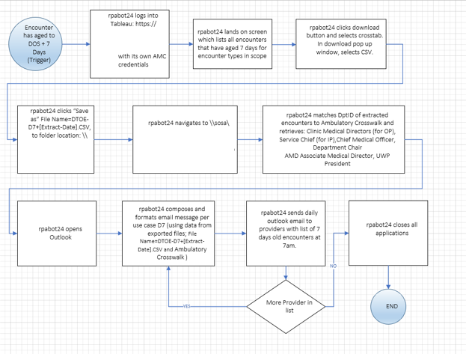
FUTURE STATE PROCESS
Notes:
No precedence for this type of requirement
Established a workflow foundation for the proposed automation to follow

Slide 10
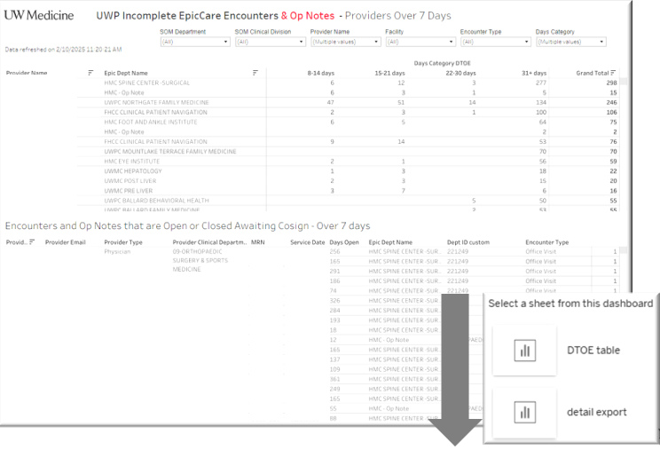


TABLEAU ACCESS & REPORT EXTRACT
Notes:
Bot logs into Tableau
Accesses UWP Incomplete EpciCare Encounters & Op Notes
Downloads two reports:
Detail export: MRN/DOS requirements along w/other Provider details on the OE
DTOE table: OE days in designated buckets
File individually saved on secure File Share

Slide 11

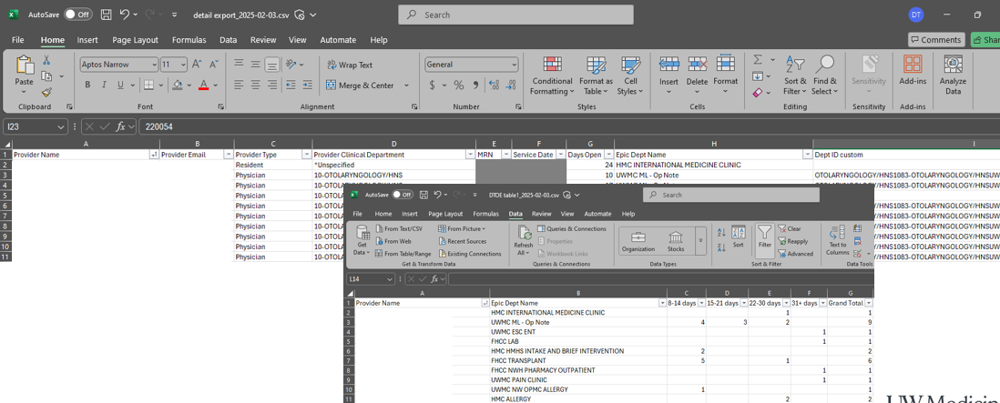

REPORT ANALYSIS & DATA PREP
Notes:
Bot accesses dl’d files from secure File Share location
Analyzes the data and preps it for Outlook migration
Bot processes each Provider line item and runs it against the Master Crosswalk to collect: Provider Name/Email & Clinical Medical Director/Service Chief

Slide 12
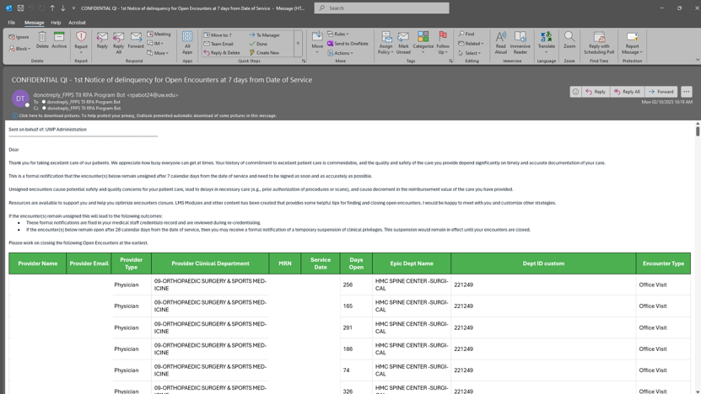


EMAIL NOTIFICATION
Notes:
Bot opens outlook and appends all the collected data from the files onto the email template body.
Bot sends out the email based on the provided Crosswalk

Slide 13
RETROSPECTIVES
CHALLENGES
WINS
PROJECT
Agile/Scrum Approach
Leveraged SMEs within area of expertise
Seamless collaboration across project teams: Stakeholders, Sponsors, Operations Excellence, Analytics & Technology Improvements/Innovation
DEVELOPER
Increased knowledge on UiPath activity workflows
Basic coding knowledge
Relationship between Orchestrator & UiPath Studio
Standardization of Automation Documentation & Publication process
PROCESS
No standard foundation for this process
Creation of a process to mirror automation
Identifying a mix of appropriate data
TECHNICAL
Steep RPA learning curve
Detailed knowledge on UiPath codes
Knowledge on use of more optimized or robust UiPath activities

Slide 14
CONFIDENTIAL – DO NOT DISTRIBUTE

