Slide 1
Driving Impact Through Automation
August 2025

Slide 2
Agenda
Introductions
Overview of Our Automation Program
    Our Automation Team
    Governance Structure
    Key Pillars
    Scope and Key Goals
    Tools and Tech
Measurable Impact and Major Successes
Challenges and Lessons Learned
Future Focus and Next Steps
Open Discussion and Q&A

Slide 3
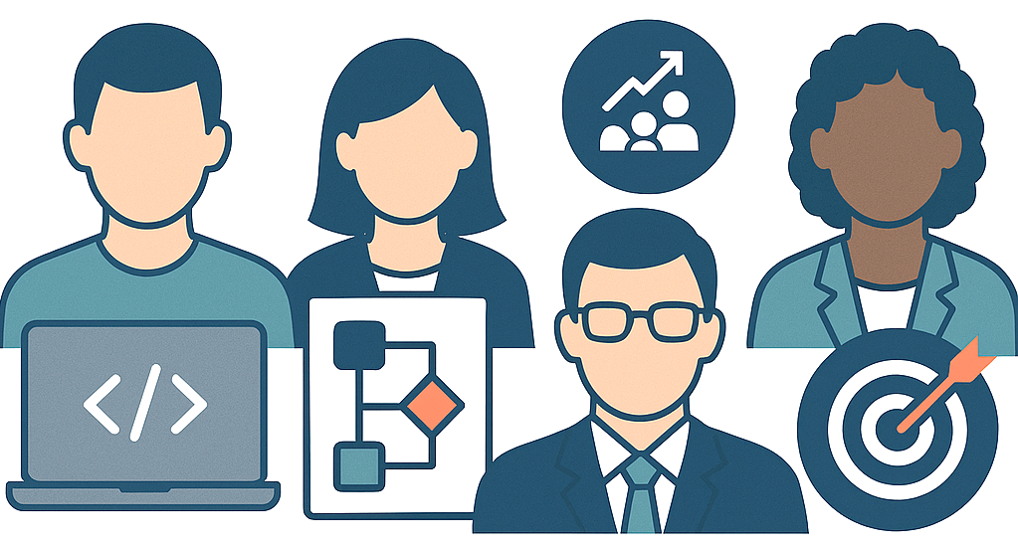
Our Automation Team
Launched in 2019, our Automation program has grown significantly, expanding across most RCO departments
1
Program Director: Aligns automation efforts with enterprise goals
1
Manager: Leads development strategy, mentoring, review, intake/prioritization
2
Senior Solution Designers: Identify, evaluate, design, document automation solutions
4
Developers: Build, test, deploy, and maintain automation solutions

Slide 4



Governance Structure
Revenue Cycle Operations (RCO)
Owns automation strategy and delivery
Revenue Cycle Automation Team within RCO
Manages the entire automation lifecycle
Department of Intelligent Automation (DIA) within the Enterprise Digital oversees and maintains the digital infrastructure

Slide 5
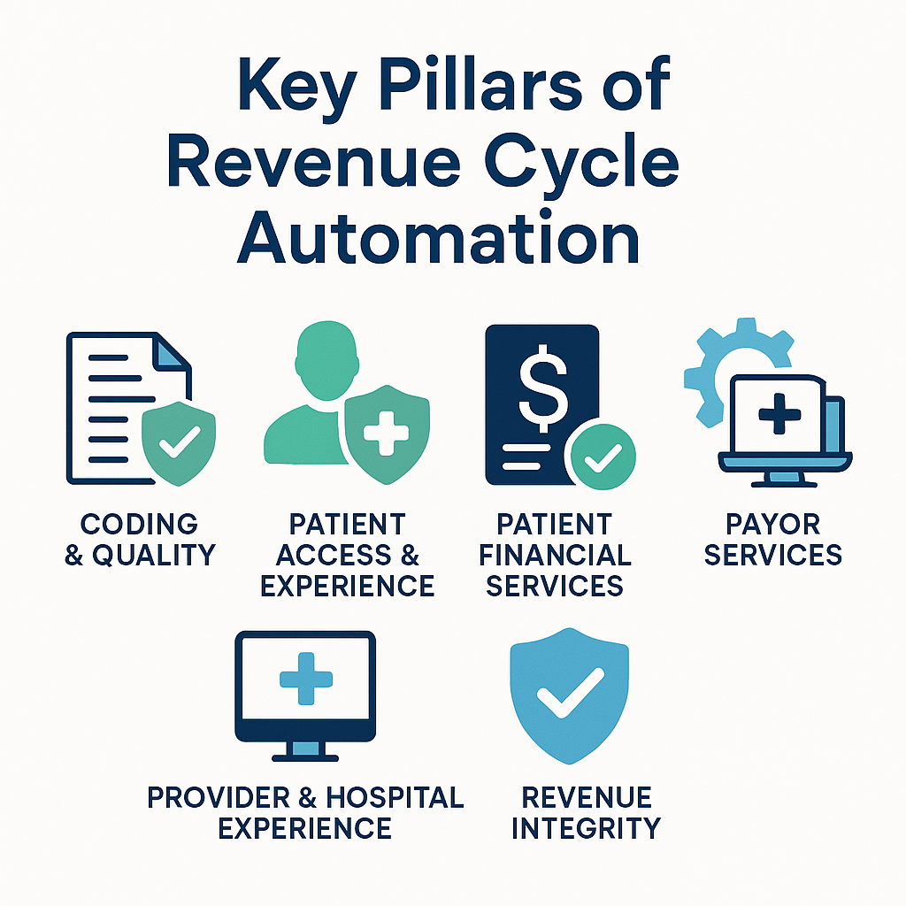
Key Pillars of Revenue Cycle Automation

Slide 6







Scope and Key Goals
  Automate high-impact, repetitive tasks
  Minimize manual effort and errors
  Speed up turnaround times
  Unlock staff capacity for higher-value work
  Expand automation capabilities with APIs, OCR, ML, and NLP
  Elevate the customer and patient experience

Slide 7

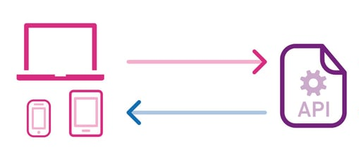



Tools & Tech

Slide 8
Program Growth & FY25 Impact
Expanded to 40 live automations to date, covering most RCO departments and functions, with many more in development and design
Strong intake process and governance ensure sustainable expansion
In FY25 alone to date:
  Reallocated the equivalent of over 50 FTE hours within the RCO
  Reallocated approximately $3.5M in labor value
  Completed over 1.5 million transactions

Slide 9



Major Successes
Automation | Scope | Result
HB/PB Refund Requests | Automates Epic refund request by checking, validating balances, patient status, and payment method to ensure accurate, timely refunds request. | Replaced manual checks across multiple service areas for a high volume of cases, ensuring accurate and timely refund requests. In FY25 to date, reallocated the equivalent of 6.5 FTE hours and approximately $440k in cost through accurate, timely refund request processing.
HB/PB Refund Approvals | Automates review and approval of self-pay refund requests across 65+ Epic work queues, validating balances, adjustments, and payment details for accuracy and efficiency. | Replaced inefficient auto-approval and manual approval process for high-volume refunds, ensuring accurate and timely approvals of refund requests. In FY25 to date, reallocated the equivalent of 10 FTE hours and approximately $800k in cost through accurate, timely refund approvals.

Slide 10
Major Successes
Automation | Scope | Result
Correspondence Posting | Automates end-to-end denial and correspondence posting by integrating OnBase, ABBYY Vantage, EDW, and Epic. Pulls payer response and medical record files, extracts relevant data, validates through mapping tables, and posts records in Epic to route to the correct WQ. | Replaced a manual, complex multi-system process prone to delays and data entry errors, improving the accuracy and speed of denial and correspondence posting. In FY25 to date, reallocated the equivalent of 6 FTE hours and approximately $420k in cost, while also enabling faster work queue routing and improving denial turnaround.
PCP Mismatch Alerts | Automates outreach for patients flagged with a PCP mismatch by checking RTE responses, extracting the correct PCP name, and sending In Basket messages prompting updates. | Replaced a manual, time-consuming process for resolving PCP mismatches, reducing delays and ensuring timely follow-up. In FY25 to date, reallocated the equivalent of 2 FTE hours and approximately $140k in cost annually through faster, more accurate PCP mismatch resolution.

Slide 11
Major Successes
Automation | Scope | Result
Referral Submissions | Automates referral submission for patient encounters requiring them by identifying referrals in Epic with a shell status of “Blank” or “New Request”. It verifies PCP and eligibility through RTE, confirms service date, and ensures the referral is correctly populated in the shell after submission. | Replaces a manual, repetitive process, reallocating approximately the equivalent of 3 FTE hours and $194k annually. Improves the accuracy and timeliness of referral creation, reduces the risk of service delays, and ensures consistent referral handling across encounters.
Referral Inquiries | Automates referral inquiries by integrating Epic with payor websites. Prioritizes accounts by location and service date, searches and validates referral details, updates or corrects Epic referral lines, and flags missing or invalid referrals for staff review. | Replaces a manual, time-consuming process, improving the accuracy and timeliness of referral updates. Once all payors are integrated, we expect to reallocate the equivalent of 5 FTE hours, approximately $356k in cost, reduce the need for manual review, standardize referral validation across payors, and reduce referral-related claim issues.

Slide 12

Challenges
Passive intake limits opportunity discovery​
Knowledge gaps on automation potential​
Competing priorities​
Concerns about job security
Process variation across departments​
Frequent workflow and system changes​
System and integration constraints​

Slide 13

Lessons Learned
Proactive idea sourcing is essential
Structured intake process improves quality
Workshops drive engagement and awareness
Quality and visibility strengthen adoption
Transparency builds trust in automation’s purpose
Early process standardization enables scaling
Close coordination with operations reduces impact of workflow changes
Technical planning improve automation reliability

Slide 14
Future Focus - Building on Our Automation Foundation
Keep improving through feedback and data
Broaden impact across RCO
Continue to enhance the intake process
Deliver faster without sacrificing quality
Enable and support self-service automation
Design with scalability in mind
Keep building trust in Automation

Slide 15





Next Steps – our FY26 Priorities
Payer Policy Pilot (RPA + Copilot agents)
Evaluate and integrate emerging AI tools
Expand API integrations
Deploy a new ABBYY build
Strengthen technical foundations through partnership
Maintain skill development

Slide 16
In Summary
Strong Growth & Impact: 40 live automations with more coming, $3.5M in labor value reallocated in FY25, over 1.5M transactions processed
Overcoming Challenges: Leveraging structured intake, proactive idea sourcing, and workshops to drive engagement and adoption
Solid Foundation: Strong cross-team coordination enabling sustainable scaling
Looking Ahead to FY26: Expand automation reach, strengthen technical capabilities, and deliver measurable value across RCO

Slide 17

Open Discussion and Q&A

Slide 18
For Questions Reach Out To
Mane Chilingaryan (mchilingaryan@mgb.org)
Manager, Intelligent Automation - Revenue Cycle Operations
David J. Travis (dtravis@mgb.org)
Senior Solutions Designer - Revenue Cycle Operations

