Slide 1
Auto-Bot in Action:
Turning Automation Faults into
Incidents Automatically
Improving visibility, response times, and operational efficiency
PRESENTED BY
Brian McDermott
Jonathan Straub
Micheal Jacomine
1
Notes:
Punchy Title & Tagline highlighting an automation to monitor & log faults
Tying into the theme of support & sustainability

Slide 2
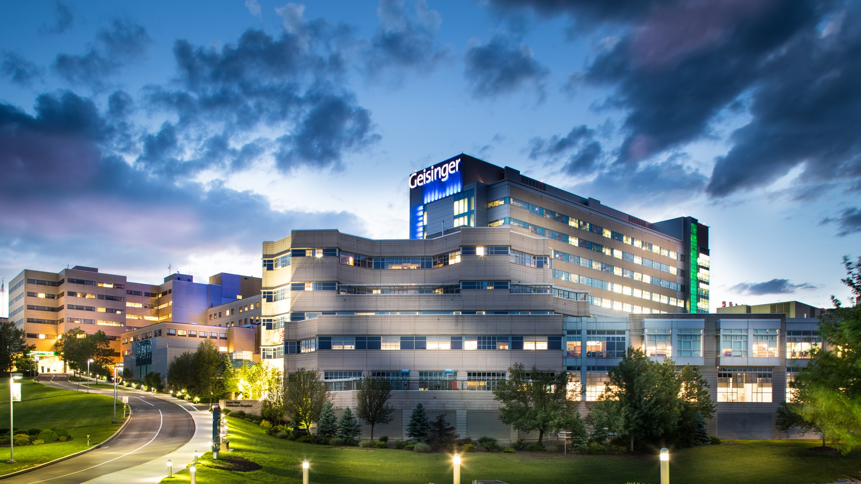
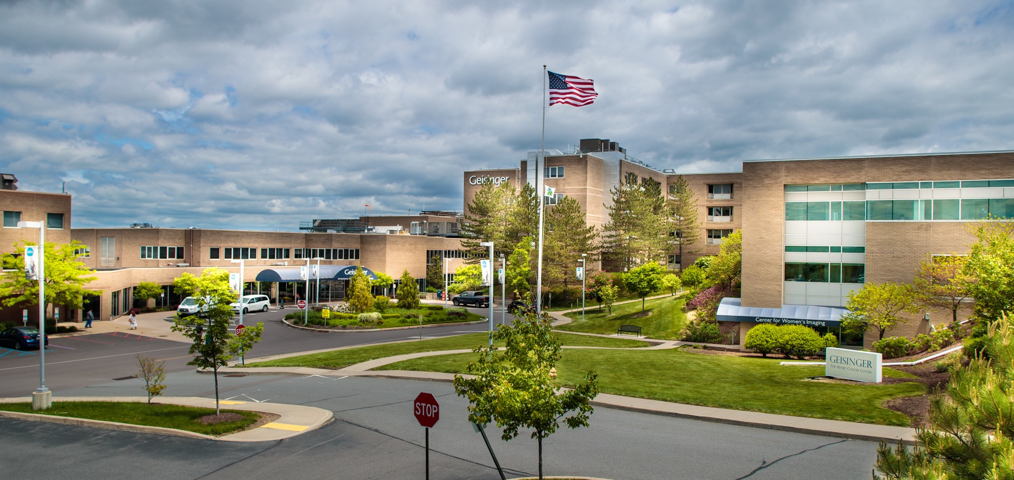

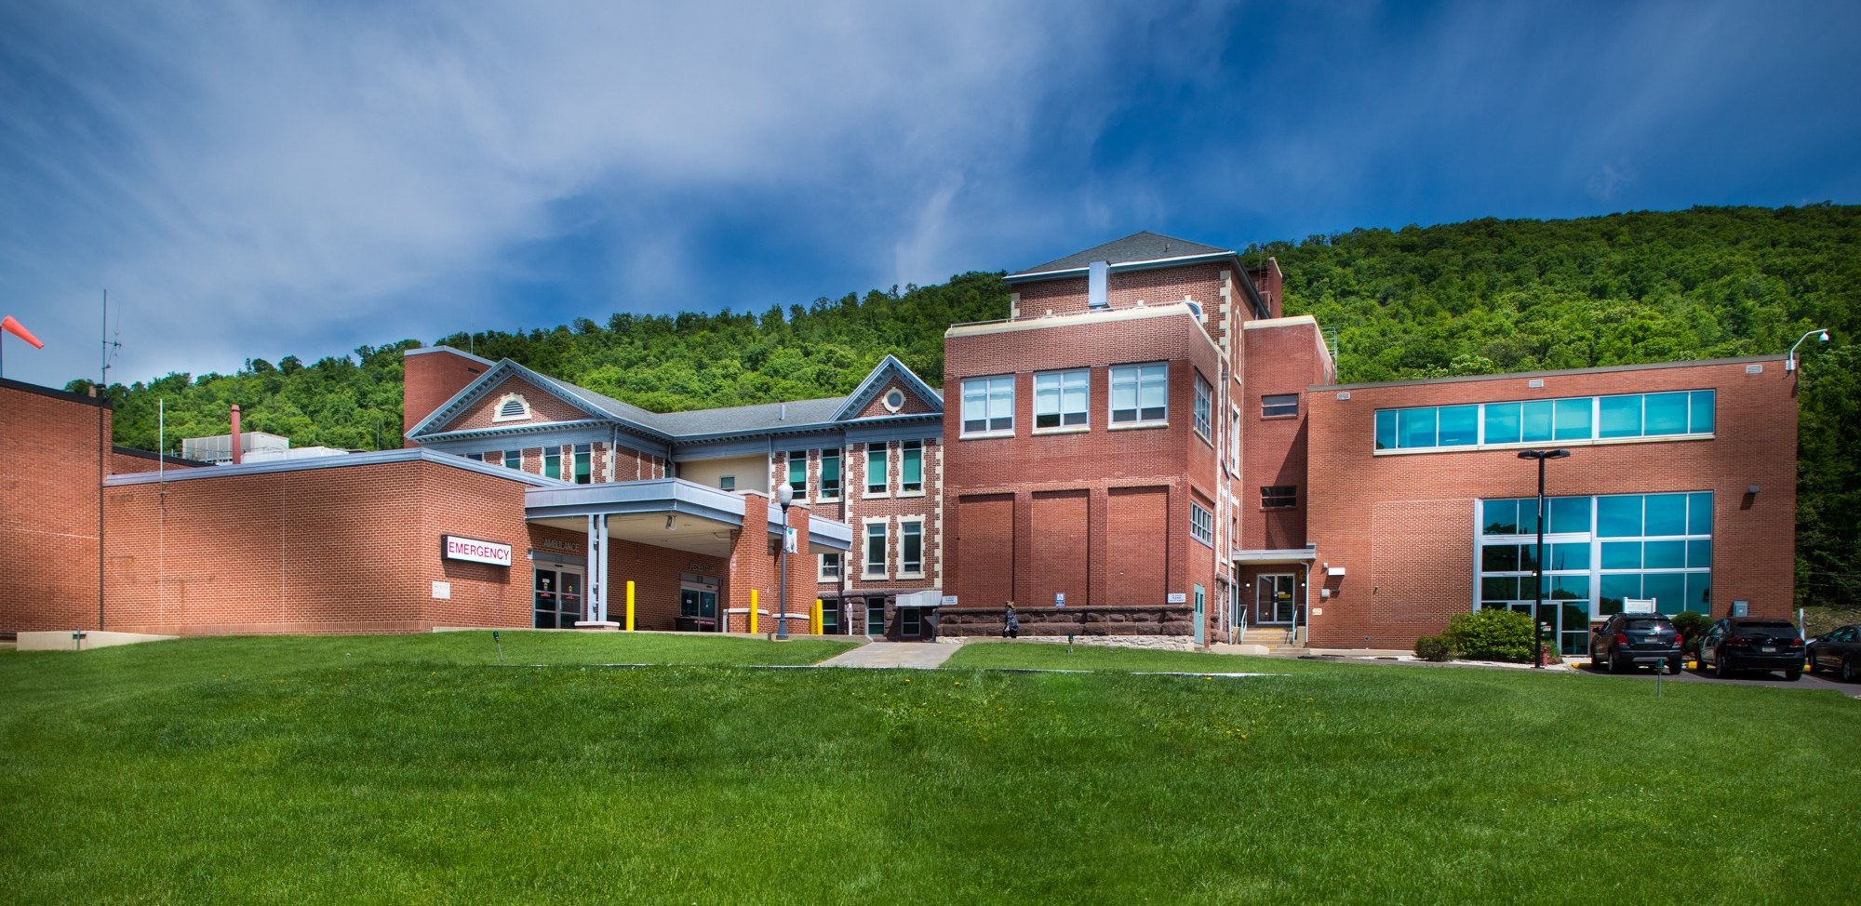
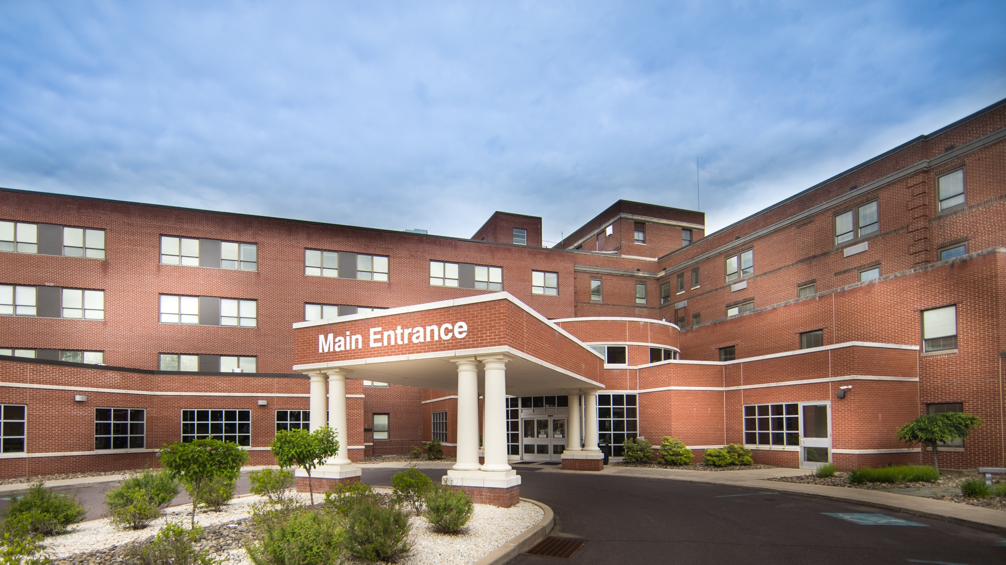
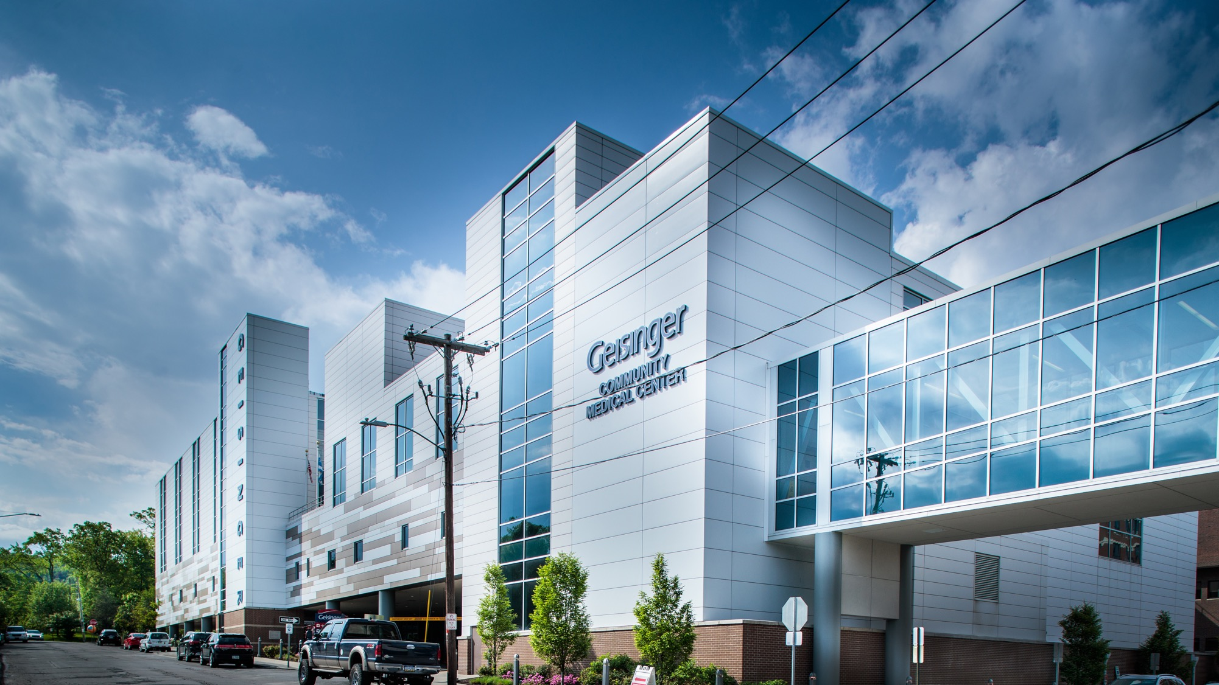
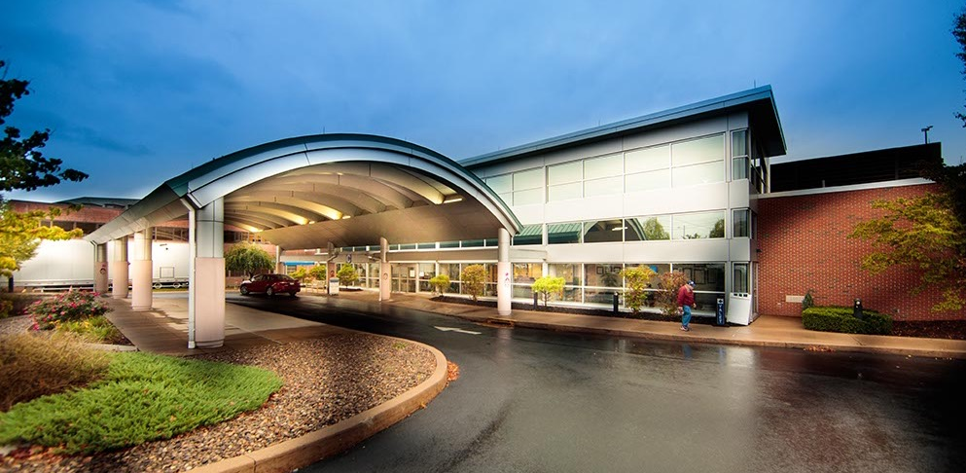
2

Slide 3
We care for patients.
• 10 hospital campuses
• 130+ primary and specialty clinics
• 28,600+ employees
• 1,900+ employed physicians
• 1,300+ advanced practice providers
• 5,400+ registered nurses
Geisinger:
Integrated health system with
$9 billion
in combined
revenues
We provide quality, affordable healthcare coverage.
• More than 509,000 Geisinger Health Plan
enrollees
• More than 66,000 contracted providers
in network
• 213 hospitals in network
We shape the future of medicine.
• 460+ MD students at Geisinger
Commonwealth School of Medicine
• 80+ students at Geisinger School of Nursing
• 1,600+ active research projects
3
Notes:
•For more than 100 years, Geisinger has been dedicated to providing the best care available to the communities we serve. And although we have grown significantly since 1915, our mission, our values and drive to deliver the best care has been constant.
•This is Geisinger today. 10 hospital campuses, more than 1,900 employed physicians, more than 509,000 health plan members, $9 billion in annual net revenue.
•While hospital care is critical to our mission, healthcare is changing, and our focus has been to move care closer to our patients and members. This has resulted in an expansion of ambulatory care sites for primary, specialty and urgent care, including walk-in clinics, retail and home-delivery pharmacy, lab and imaging centers. This aligns with our focus on health prevention, early intervention and chronic disease management. We believe putting care closer to the patient and member is the best way to achieve that, including offering care at home through programs like our Geisinger at Home program or by using technology such as telemedicine visits.
•And we are a teaching and research institution with a school of medicine, school of nursing, and a research center that oversees more than 1,600 active research projects at any given time.

Slide 4
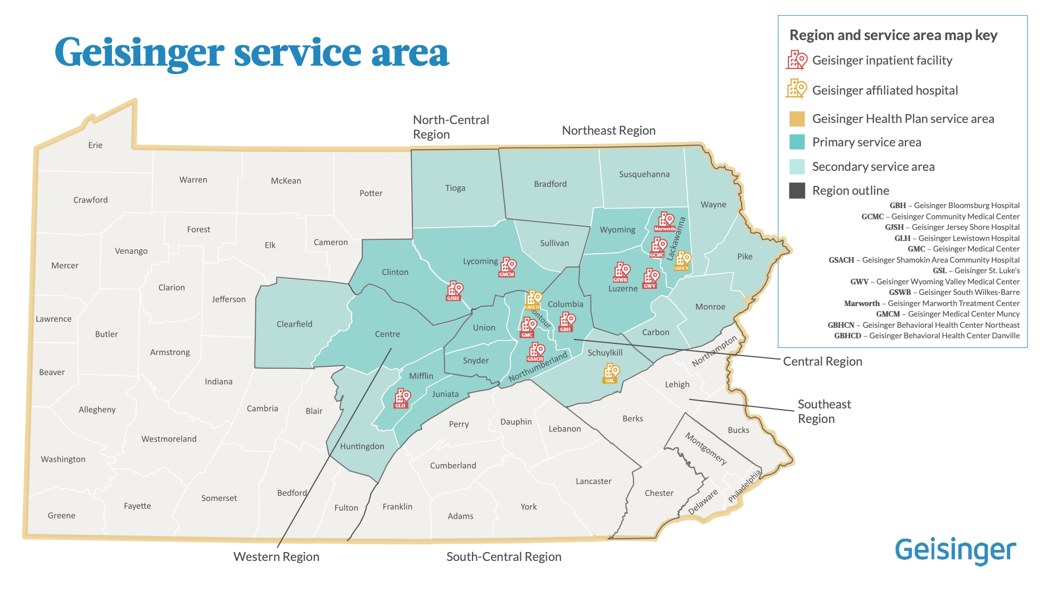
4
4
Notes:
Today Geisinger has grown to be one of the largest integrated health systems in the country, caring for more than 1 million people annually.
Geisinger’s service area extends across 46 of Pennsylvania’s 67 counties, home to nearly 6.7M
The darker green counties represent our primary service area – from Scranton and Wilkes-Barre in the northeast across our headquarters and home of our original hospital in Danville and west to State College and Lewistown. Geisinger is the dominant brand in preference and awareness and leads in share of care in the Central and Northeast regions.
The lighter green, our secondary service area, represents areas where we are growing.
Our health plan service area includes all Pennsylvania counties, going well beyond the communities served by our physicians, hospitals and clinics. Our health plan markets are served by contracts with a strong provider network that includes collaborative relationships with other regional providers such as St. Luke’s, Mt. Nittany, Evangelical, WellSpan and Guthrie.
In 2017 we added the Geisinger Commonwealth School of Medicine in Scranton to our portfolio, which has allowed us to tailor medical education to Geisinger’s approach to health care. The school has become a critical element in our strategy as it provides a pipeline for homegrown talent.

Slide 5
About the Intelligent Automation Hub
Steele Institute for Health Innovation, Automation Center of Excellence
Who We Are
— Established in 2019
— 24 members across business architecture, development, infrastructure, and support
— We partner with internal teams to automate high-effort processes
— We research and deploy leading-edge automation tools across the organization
80+
Live Automations
22.4M+
Transactions Processed
1.4M+
FTE Hours Saved
$183M+
Overall Realized Benefits
Notes:
Robot actions = actions of a user

Slide 6
Challenges of Growth
Scaling the portfolio scaled the support burden with it
Automation Fault Monitoring
Failures surface only when someone happens to notice them.
Troubleshooting
Root-cause analysis competes directly with new build work.
General Stability Upkeep
Restarts, scheduling and cleanup are handled ad hoc.
Applications Upgrades
Vendor releases quietly break automations that were working.
Automation Tool Upgrades & Deprecations
Platform changes force rework across the portfolio.
Business Process Redesigns
Every process change ripples into the bots that run it.
Notes:
Jonathan:
"With growth came challenges—ad hoc restarts, scheduling, troubleshooting, tool upgrades, and redesigns. We initially started with a few low-ROI automations to prove value, but as we scaled, maintenance demands grew exponentially."

Slide 7
Support & Sustainability:
Why It Matters
Timely Triage
Automation
CoE
Support
Cost of Growth
Transcend Go-Live
Timely Triage=
Program Trending
7
Notes:
Timely Triage – Entering issues from emails can impact the ability to triage issues in a timely manner
Costs of growth – funding a support pod and headcounts in a cost constrained world where you prove $ to value
Transcend Go-Live – great you built it, it works and that’s it right?.... not so fast app upgrades, unexpected changes and various issues can and will arise the longer your automations run and wider the scope
Program trending – standards for not only how you build or name things but how you handle errors, faults and failures – consistency upfront is great but you may need to consider how standard if wishing to automate - Ability to trend commonfailures and bundle likeissues. Consistentnaming, common threadtying together

Slide 8
UiPath Fault Management
BEFORE AUTO-BOT
UiPath Faults
Every fault was found, assessed, and logged by hand. Analysts pieced the picture together from several systems, with no consistent record of what broke or why.
WHO
WHAT
Where
Support Analysts
Assess & Log Faults
Multiple Sources
1.5 hrs/day
of analyst time spent on manual triage
IMPACT
Timely Triage=
1.5 Hours / Day
Untimely Triage
Error Prone
Low Value
Inconsistent
Duplicative
8

Slide 9
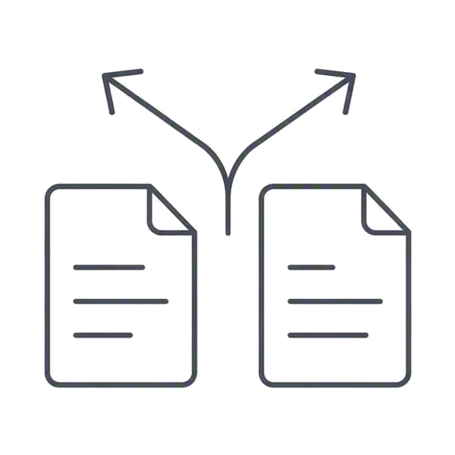
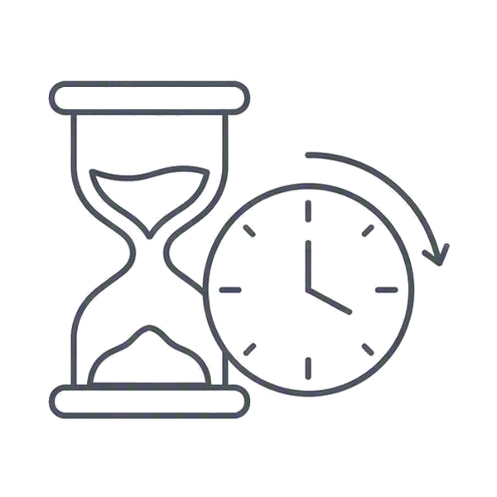

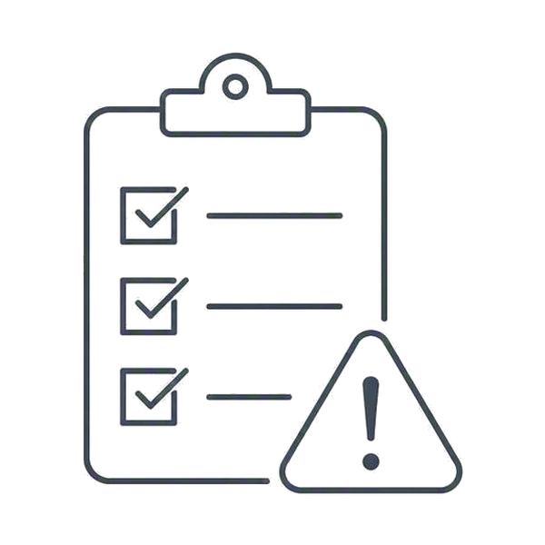
The Cost of Standing Still
Risks of continuing manual, email-based support
Inconsistency
Analysts interpret errors differently, reducing reporting reliability.
Latency
Manual review delays incidents during off-hours and peak volume.
Knowledge Gaps
Quality relies on individual experience and tribal knowledge.
Compliance Risk
Missing documentation and duplicate tickets complicate audits.
THE COST
Staying manual means 1.5 hours a day of analyst time, every day
9

Slide 10
Project Foundation
Why consistency was required and how the data foundation was built

Slide 11



Consistency First
01
02
03
Standardization
Consistent UiPath naming and folder structures enabled accuracy.
ServiceNow Setup
Clear categories and priorities ensured reliable assignment.
Reliable Monitoring
Predictable notification formats enabled effective parsing.
THE PAYOFF
Enforcing standards upfront reduced rework and built trust in the data
11

Slide 12
Building the Data Foundation
Turning raw signals into actionable incidents
RAW INPUT
WHAT WE BUILT
WHAT ANALYSTS GET
Inventory and Mapping
Link automations, identifiers, and ownership.
Classification and Routing
Separate fault types and route them to the right teams.
Normalized Repository
Enrich raw inputs into incidents an analyst can act on.
Scattered Signals
01
Inventory and Mapping
Every automation tied to an owner and an identifier.
One Clean Record
Orchestrator job logs
Named automation and owner
02
Classification
Fault types separated and consistently named.
Assorted error codes
Consistent fault category
Free-text fault notes
03
Enrichment
Context added so the record stands on its own.
Routed to the right team
No shared identifier
Auditable and reportable
WHY IT MATTERED
Nothing downstream works until the inputs mean the same thing.
12

Slide 13
UiPath Faults to ServiceNow
Tailored fault tracking built around how Geisinger actually works

Slide 14



Advent of AutoBot
Phase 1 (Attended)
Email to ServiceNow Conversion
550+
hours saved per year
$40,000+
in annual FTE savings
STEP 1
Fault Email
UiPath emails the fault as it happens.
STEP 2
AutoBot Reads It
The bot parses and classifies the fault.
STEP 3
Incident Created
A routed, actionable ticket is created.
Analysts moved from data entry to resolution.
14
Notes:
Silent Faulting
Inconsistent naming & standardization
Exception classification

Slide 15
Phase 1: Attended AutoBot
Attended design, dashboards, and Phase 1 outcomes

Slide 16
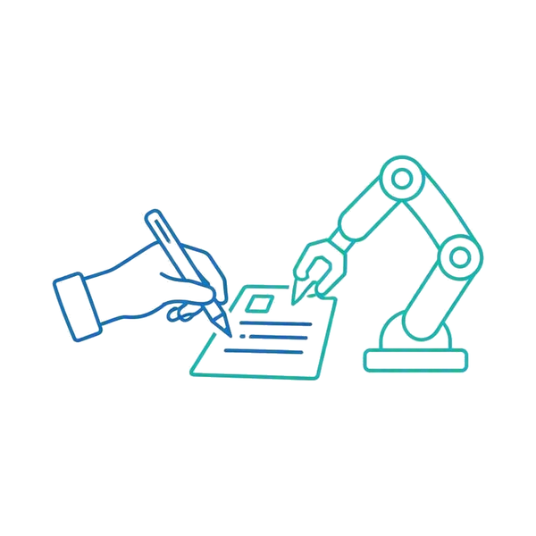


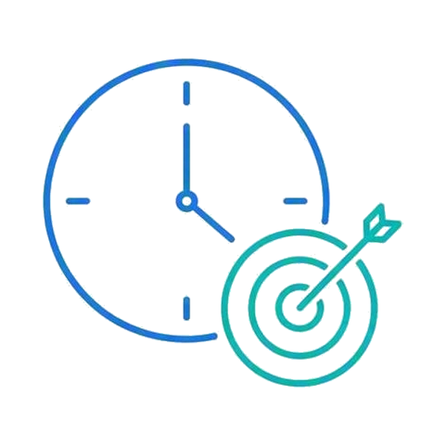
Attended by Design
The four choices that made Phase 1 work
01
Attended Model
AutoBot prepares incidents from failure emails under human oversight.
02
Analyst Role
Analysts review, adjust, and approve tickets to validate performance.
03
Change Buy-In
Positioning the bot as an assistant builds trust and collaboration.
04
Targeted Rollout
Deployed in morning support hours to focus on high-impact periods.
WHY IT MATTERED
Human oversight built the trust that made unattended possible.
16

Slide 17
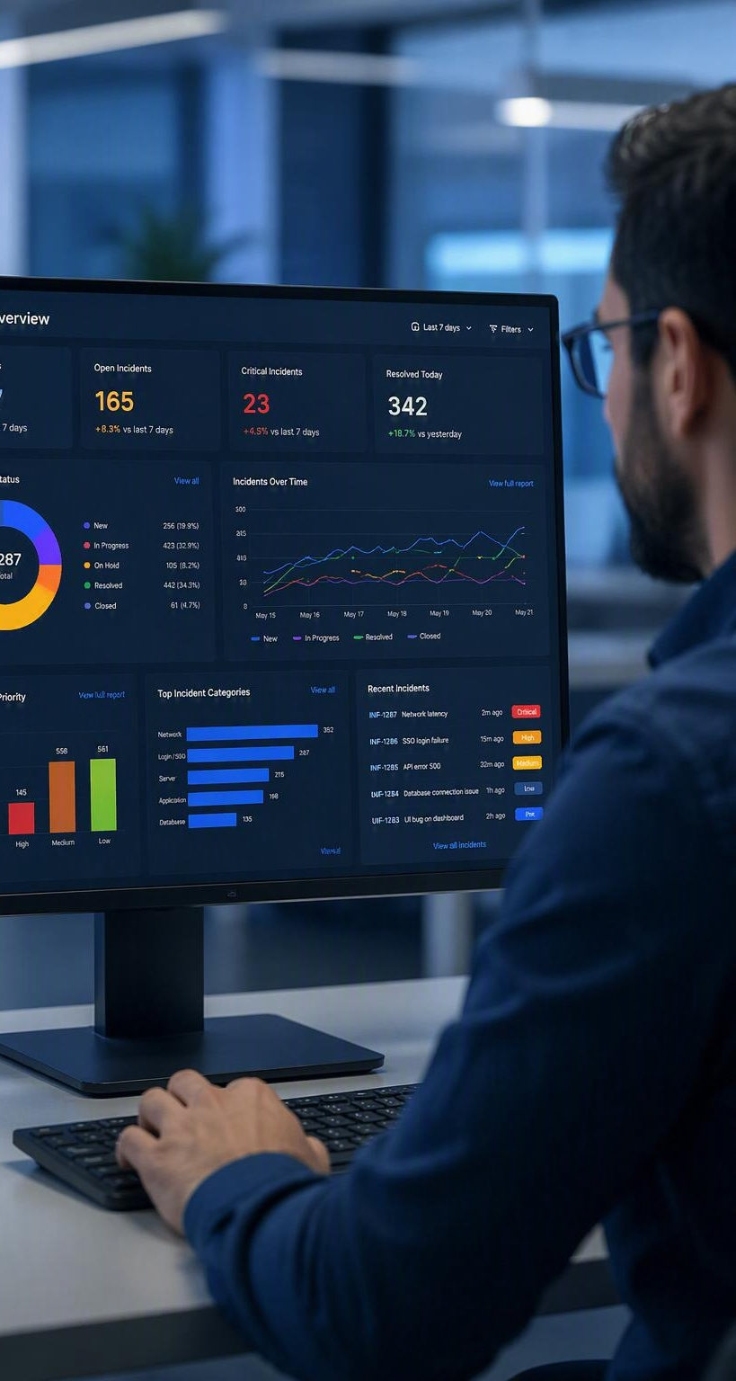


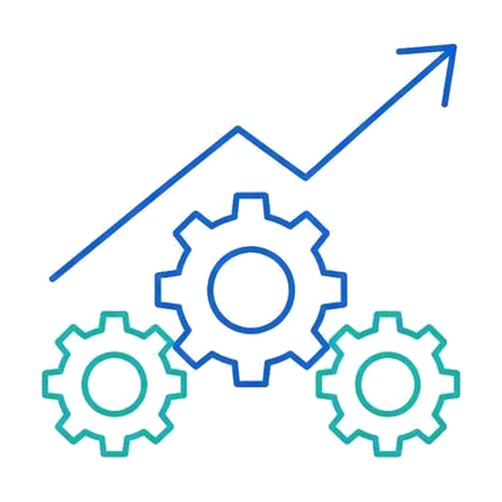
What Phase 1 Delivered
Dashboards, better tickets, and time back for analysts
550+
hours saved per year
$40,000+
in annual FTE savings
Dashboard Visibility
Centralized dashboards replaced inbox monitoring and improved tracking.
Better Tickets
Faster, higher-quality ticket creation with less manual effort.
Operational Gains
Less repetitive work, clearer expectations, and data for improvement.
17

Slide 18
Phase 1 Challenges
What we learned and how we fixed it
Challenges
Solutions
Attended Automation (Manual execution)
1
HTTP Webhooks to report & listen for Faults (Automated execution)
Emails lack fault reason, limiting de-duplication abilities
2
Data gather faults from Orchestrator API (Enriched dataset)
ServiceNow UI based, limiting robust integration points
3
Leverage ServiceNow API to Gather, Create & Update Incidents
18

Slide 19
Phase 2: Vision and Value
The backend vision, measuring value, and lessons learned

Slide 20
Phase Comparisons
From manual triggers to an API-first pipeline
Phase 2 Benefits
Phase 1
Phase 2
Email Monitor
(Manual)
HTTP Listener
(Automated)
Real-time monitoring & fault ticketing
API first architecture
Enriched data collection – informed fault processing
Ability to status Open ServiceNow Incidents
Incident consolidation & de-duplication
100% backend, minimizing fault potential
Trigger
Outlook Emails
Data Collection
Orchestrator API
Status ServiceNow
Merge “Like” Faults
Update Open Incidents
ServiceNow UI
Data Entry
ServiceNow API

Slide 21
The Backend Vision
From attended automation to API-driven incidents
PHASE 1 — ATTENDED, WITH A PERSON IN THE MIDDLE
Automation Fault
A job fails in Orchestrator
Analyst Notices
Someone has to be watching
Manual Entry
Details retyped by hand
Incident Created
Minutes or hours later
API-Driven Creation
Backend APIs and rules engines create incidents automatically.
Security and Reliability
Repeatable execution, deduplication, and auditability keep processing safe.
Value Framework
Savings quantified transparently across hard and soft benefits.
PHASE 2 — API-DRIVEN, NO HANDOFF
Automation Fault
The same trigger event
API and Rules Engine
Validates, deduplicates, routes
Incident Created
Immediately, every time
WHAT CHANGES
A fault becomes a ticket without anyone noticing it.
21

Slide 22
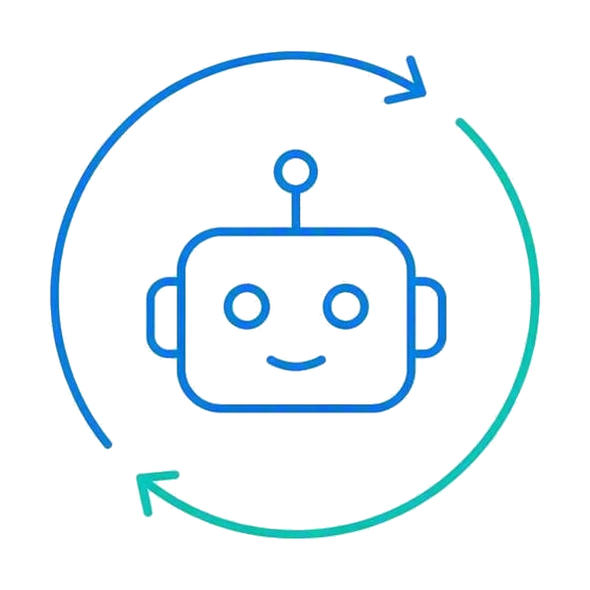


What Comes Next
The agentic roadmap beyond Phase 2
Phase 2 Targets
More hours back
beyond the 550+ already saved in Phase 1
Greater FTE savings
on top of $40,000+ in annual savings today
AI and agentic capability
as the platform and the use cases mature
NEXT 01
Fully Unattended
Faults processed end to end with no analyst in the loop.
NEXT 02
Predictive Alerting
Patterns surfaced before they become incidents.
NEXT 03
Self-Healing
Common faults resolved automatically at the source.
Each step compounds the time already given back.
22
Notes:
The potential future of Autobot

Slide 23


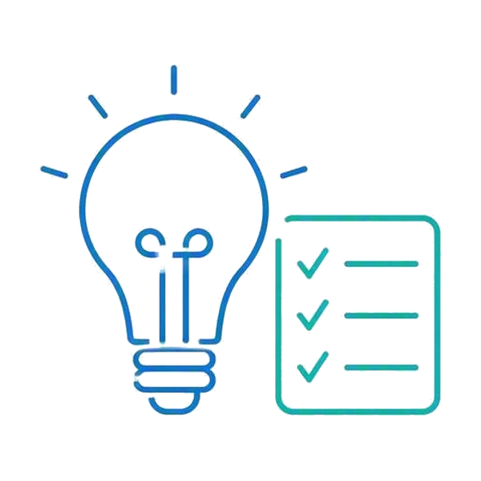

Challenges and Lessons
What proved hard, and what we would carry forward
WHAT WAS HARD
WHAT WE LEARNED
Tech Challenges
Variable email formats and duplicates required constant parsing refinement.
Org Challenges
Defining ownership and building trust demanded clear communication.
Key Lessons
Standardization, attended rollout, and exception handling are critical.
Measuring Value
Transparent outcome measurement and sharing build lasting credibility.
The hard parts were rarely technical.
23

Slide 24



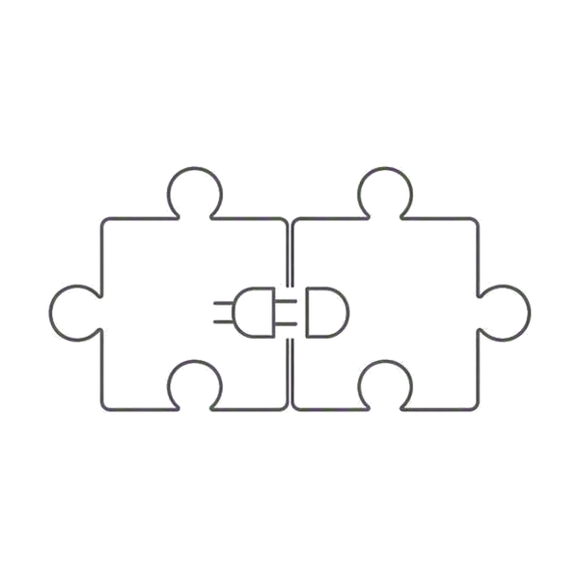
Impact and Open Items
What changed for the team, and what still needs partners
IMPACT TO THE CoE
STILL OPEN
Quality of Life
Less repetitive triage and fewer support interruptions.
Application Owner Concerns
Ownership and change control need alignment before scaling.
Top of Skill
People spend their time on judgment work, not data entry.
IT Partner Connections
New system integrations depend on partner-side access.
WHERE WE LANDED
Consistent inputs made everything after them possible.
24
Notes:
Ticket takers, triage and resolution to ?

Slide 25
Thank You
Questions and discussion

