Slide 2
UiPath Fusion Event Notes & General Themes
Fusion 9/29/2025 - 10/02/2025

Slide 3
Agenda
What was Fusion?
Sessions Overview
Keynote announcements
Thoughts on announcements
Session Highlights
What does it all mean?
Questions/Discussion

Slide 4
What was Fusion?
2024 – Forward
Looking forward, how will organizations leverage LLM/Agents/AI in general
Key announcements around Healing Agents, Document Understanding, hints of Maestro
Main Themes: AI is going to change/replace everything
2025 – Fusion
How do we fuse AI into current processes
Key announcements around orchestration, new functions, AI/vendor partnerships, governance
Main Themes: AI is hard, Orchestration & Governance are the foundation
Register for the playback to watch recorded keynote presentations
https://www.uipath.com/events/fusion/best-bits/event-pack
Follow the link to look at the biggest product announcements from the event
https://www.uipath.com/blog/product-and-updates/fusion-2025-agentic-ai-biggest-product-announcements
Notes:
2024 very light on healthcare use cases in examples – 2025 very heavy on healthcare use cases

Slide 5
Sessions Overview (Tarpon attended)
https://www.uipath.com/events/fusion/agenda (<-- full list of sessions)
Sessions attended:
Making Agentic AI Work for You – Tying Solutions to Strategic Business Problems
UiPath Vision of an Agentic World (Keynote) **Recording available
Getting the Most from Agentic Automation Now (Keynote cont.) **Recording available
Agentic Applications for Healthcare Providers
Agentic AI in Healthcare Finance: Netsmart’s Journey with TQA
Google Cloud and UiPath: The Role of Agentic AI
Transform Enterprise Business Processes with Maestro
Women in Automation – Leading with Impact (Phebe – Geisinger)
Healthcare Provider Summit: The New Agentic Power Grid for Healthcare Providers **Recording available
From Insight to Action: Driving Operational Excellence with Agentic AI
Leveraging Internal Agents to Accelerate Development
Unlocking Enterprise Autonomy Through Agentic Orchestration

Slide 6
Keynote Announcements (high level)
Link to photo slide each hyperlink
Maestro features (SCREENSHOT)
Case Management
Process Apps
UiPath Solutions (SCREENSHOT)
Prebuilt agentic solution – Denials management out of the box
UiPath Test Cloud (SCREENSHOT)
Simulated test cases
Test Manager integration
Studio Agent Builder
Low-code visual tool – build from scratch or template
UiPath Labs (SCREENSHOT)
Enterprise Knowledge Graph – contextual SQL querying (clarity)
Project Delegate – CLIPPY!
Agent Sandbox

Slide 7
Keynote Announcements (continued)
UiPath Screenplay
Prompt based UI-Development
Document Understanding/IXP enhancements
Agentic Document Processing
Validation Agents & prebuilt validation templates
Autopilot for IXP
Agent Guardrails (SCREENSHOT)
Custom rules to keep actions within compliant boundries
PHI masking ability – hides before referencing LLM
Unified audit trail across agents and automations
Partnerships and future plug-ins (SCREENSHOT)
GPT 5
Copilot
Snowflake
Google cloud/Gemini voice agents

Slide 8
Thoughts on Keynote and Announcements
“Case Management” type products, specifically Canvas being introduced is exciting
This will be a growing area of interest for all platforms going forward
Design and development can be centralized
“Test Cloud” type solutions can reduce missed exceptions in Design/Development before Prod
Exceptions can be tested in a simulated state to find potential edge cases or areas that require addtl development before real testing/production runs
  Exciting possibility would using screenplay/auto pilot type tools to get initial development, then simulating to a “happy path”
Screen Play & Autopilot
Prompt based development is the holy grail – this may be UiPaths version but it definitely wont be the only one
Initial development potentially done from Operations/Solution Architect/Citizen Development before Dev review?
Partnerships and plug ins are a great sign
Automation “range” of use cases expands if platforms are providing valuable plug ins (GPT/Gemini/etc).
Leans into UiPath recognizing their main strength is Orchestration and Governance. Most of these products/plug ins are available externally – but making them easier to access within one tool expands capability
Notes:
Honorable mentions – PHI masking as a built in function in Studio

Slide 9
Keynote Discussion
For anyone that attended or watched the recap videos… what did you think?
Any specific products that are of most interest to your organization?
Has anyone had hands on involvement with any of these products yet?
For non-UiPath users, have there been similar product conversations/announcements?

Slide 10
Session Highlights (Day 1)
Making Agentic AI Work for You – Tying Solutions to Strategic Business Problems (SCREENSHOTS)
Presented by Cognizant & UiPath, with the main output being “top agentic use cases for healthcare payers”
  Pending claims Assistant, Prior Auth Assistant, Appeals & Grievances Assistant, Payment Integrity Audit Assistant
One thing I liked is that they proposed a typical “business rule” approach for segmenting AR for automation and added a “data agent” to assist in the analysis. You can language-prompt the agent to look for populations that will qualify for automation X/Y/Z.
Agentic Applications for Healthcare Providers (SCREENSHOTS)
Presented by Hackensack Meridian Health SVP, with the main output being a show case of their current agents
  Post Discharge Appointment Scheduling Agent, Post Discharge Care Transition Agent, Appeals Agent
One thing that I think many will experience soon, is the look back of prior automations developed and what can be supported or replaced with agents. 200+ automations, but only 3 agents
Agentic AI in Healthcare Finance: Netsmart’s Journey with TQA (SCREENSHOTS)
Presented by Netsmart & TQA, with the main output of showcasing their success on Bad Debt with Agent orchestration (1 agent, 3 RPA, and 2 action centers)
One thing I liked was the presentation started with “How many of you are less busy since implementing agents, and even RPA for that matter”. NO ONE RAISED A HAND. They also provided 2025/2028 views that I liked.

Slide 11
Session Highlights (Day 2)
Women in Automation – Leading with Impact (SCREENSHOTS)
Presented by UiPath, FIF Collective CEO, JPMorgan Director, and Geisinger's own Phebe!
Phebe did a fantastic job! A few snippets:
  “We are at an incredible inflection point, we have a blank canvas with your name on it – claim it. As women, we are not just going to be apart of the AI transformation, we are going to lead it.”
  “In innovation we say that you need to build the plane while you're flying it. Don’t chase perfection, make progress”
Healthcare Provider Summit (recorded on “Best Bits”) (SCREENSHOTS)
Multiple presenters: UiPath (Chris Jordan), NYU Langone Health, Endeavor Health (Chicago), Montfiore (NY), Hackensack (NJ), Promptcare, VSP Vision Care, OSF Healthcare (Illinois)
Main takeaways/segments….
UiPath kicked off the summit recapping the agentic journey – again reinforcing that its governance and operational trust that wins, and failing projects lack those two items.
In 2 years you will have an agent of some kind – and in general end-to-end automations across applications will be fully unlocked with agents
Showcase of denials management asset. Review screenshots and discuss (3, 4, 5)

Slide 12
Session Highlights (Day 2 – continued)
NYU Langone Health – Manhattan (SCREENSHOT)
Demographics: $10b+ revenue, 53k employees | 125 bots, 150k hours saved
1 Agent live (Admission Medicine reconciliation), 2 in development
Main points covered related to “automations are live, now we are going to enhance with AI”. They aim to do this by starting in DU/IXP. Closing statement of “our bots aren’t going anywhere, and even more important, our humans aren’t going anywhere either”
Endeavor Health – Chicago (SCREENSHOT)
Demographics: $5B+ revenue, 27k employees | 190 bots in pipeline across 6 domains, 1k hours saved
No agents live? But use case shared was Medications Prior Auth Results Documentation
Mains points:
  They built automations for security team first to get buy in
  Instead of the Automation team determining value, the operational owner does
  “They best way to predict the future is to create it”
Provider Panel (Montfiore/Promptcare/Hackensack)
The presentation felt a little “salesy” but the points extracted were:
  Hackensack – “Go wide, not deep” for use cases in the organization. Get everyone bought in then go big
  Montfiore – “Create a roadmap that makes sense for your program”. Highlighted road mapping importance
  Promptcare – “Determine your value driver before presenting data”. How to get solve “hours” conversations

Slide 13
Session Highlights (Day 2 – continued)
VSP Vision Care (SCREENSHOT)
This lady was brilliant! Her presentation was… if you don’t do one these 4 items you will fail:
  Small bots (RPA)
    Use agents to orchestrate the small bots (modular automations)
  Curated data sets (RAG models)
    If the data doesn’t support it, move on and deprioritize for now
  Data Controls (governance)
    Each use case requires a review process and “committee” approval
  Accurate Estimations (build times/go live planning)
    Over plan and deliver quick – if you do the opposite, you have lost all trust
Also shared their Agentic Use Case Structure as well as Review/Governance Structure
OSF Healthcare (SCREENSHOT)
Demographics: $4b+ revenue, 25k employees | 120 automations, 18k hours saved
2 agents discussed around medical necessity appeals (first agent determines applicable records, second agent to create the letter)
Main points around “Garbage in – Garbage out” still exists with agents, context engineering is critical
Don’t start your agentic journey with new use cases, supercharge existing ones
Focus on “Single purpose agents” – keep the context specific and narrow. Do the one thing well, not everything poorly

Slide 14
What does it all mean?
Themes/Thoughts/etc
Agents/LLMs are here, but RPA isn’t going anywhere
Orchestration is the real value driver (make sure you're equipped to orchestrate – modular/agents)
Prompt based development is exciting, but its not quite here
You can have the best tool in the world, but without governance you won't succeed
Simulation testing will be a major unlock for code review and pre-production validation
With Agents becoming more accessible, how do I apply them to my current inventory of automations. When do I consider enhancement over net new use case development?
You are not behind, you are right where you need to be (of the 7 orgs in the summit, 400+ automations, < 6 agents live)

Slide 15
Questions / Discussion

Slide 16
Photos below

Slide 17
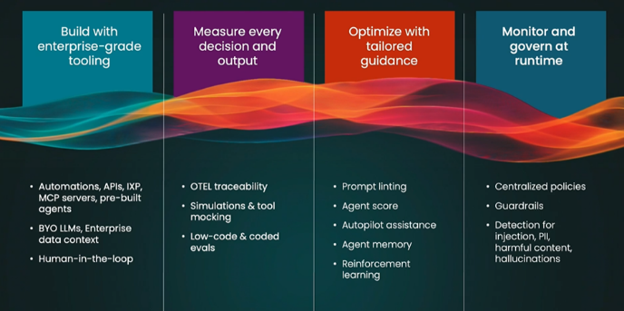
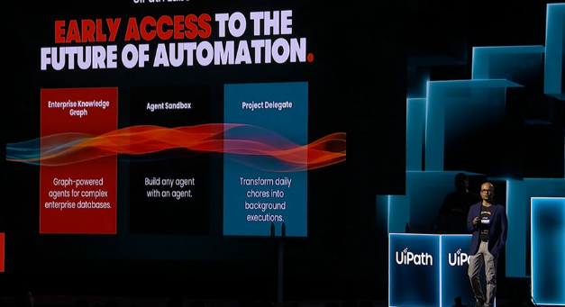
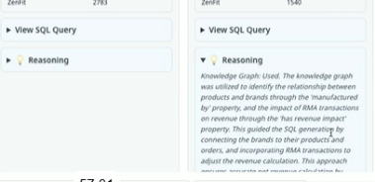
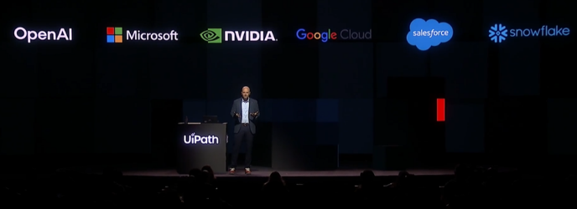
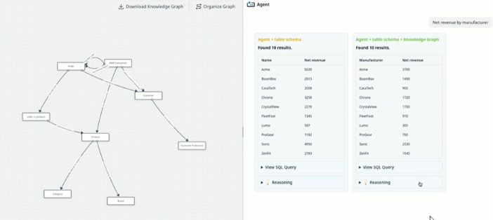
Keynote – Photos
Back to Slide

Slide 18
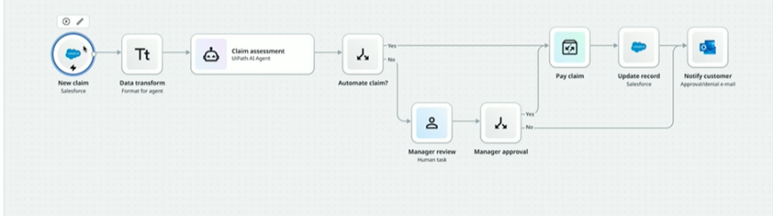
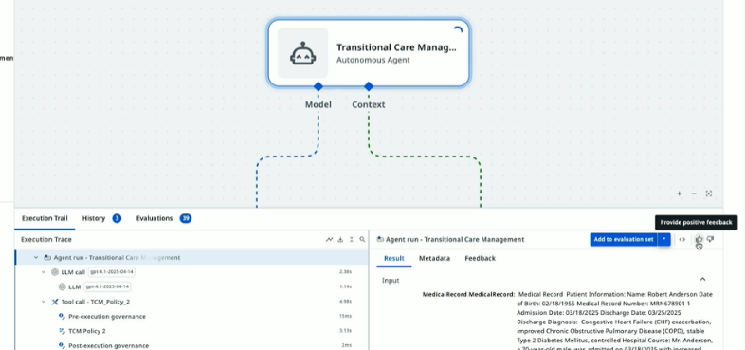
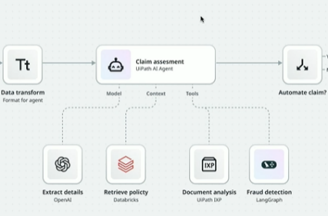
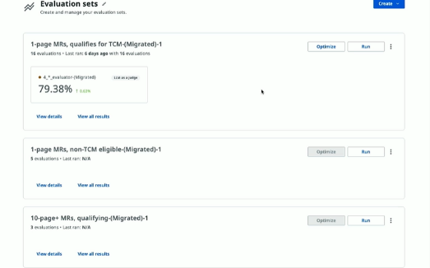
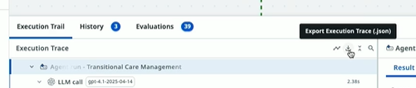
Keynote – Photos 2
Back to Slide

Slide 19
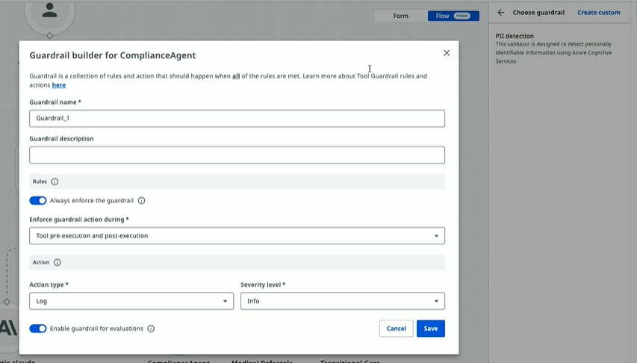
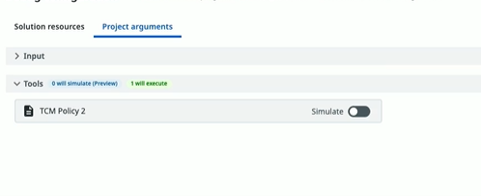
Keynote – Photos 3
Back to Slide

Slide 20
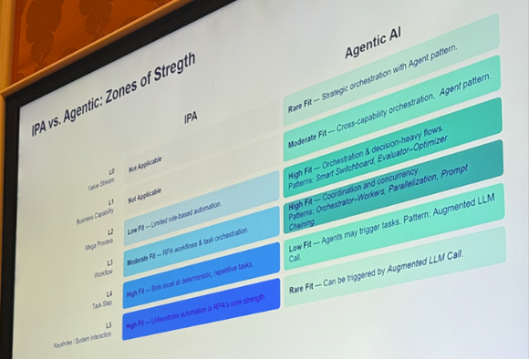
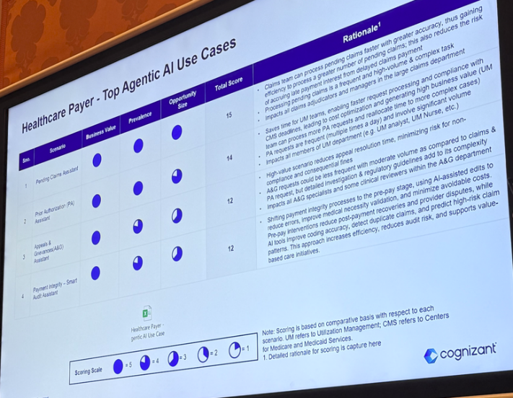
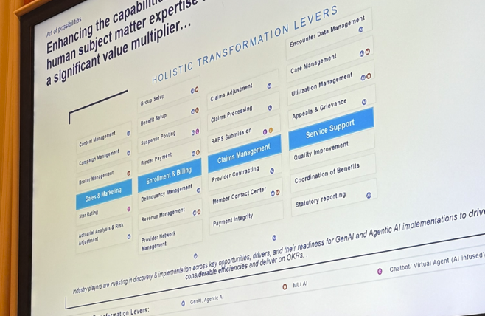
Making Agentic AI Work for You - Photos
Back to slide

Slide 21
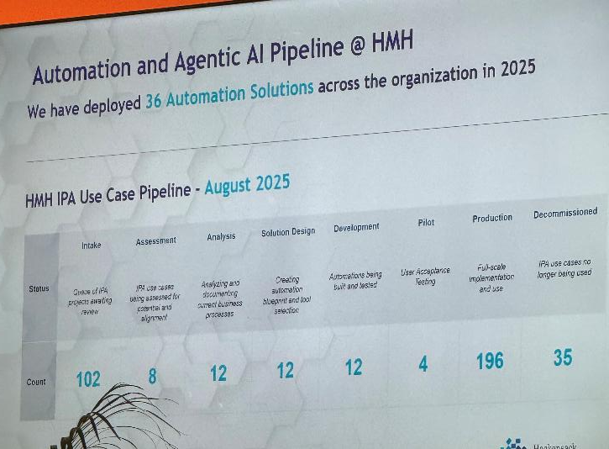
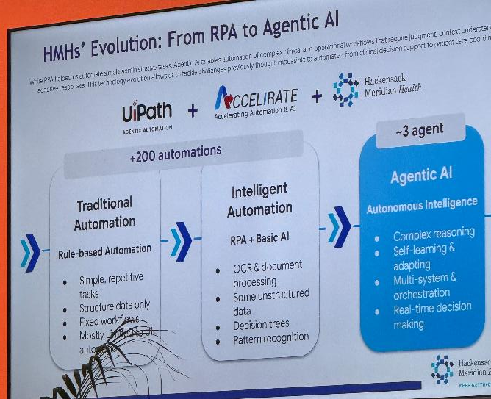
Agentic Applications for Healthcare Providers 1
Back to slide

Slide 22
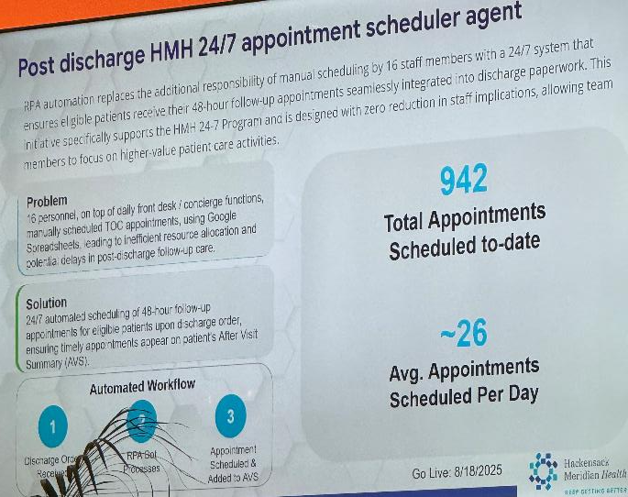
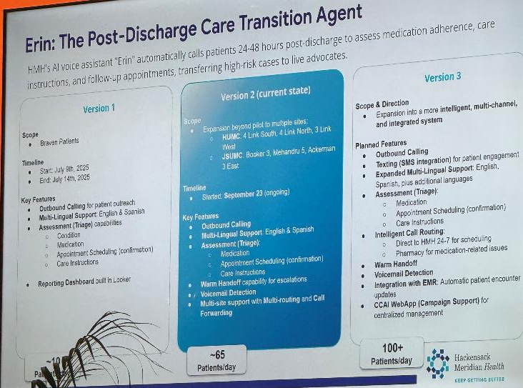
Agentic Applications for Healthcare Providers 2
Back to slide

Slide 23
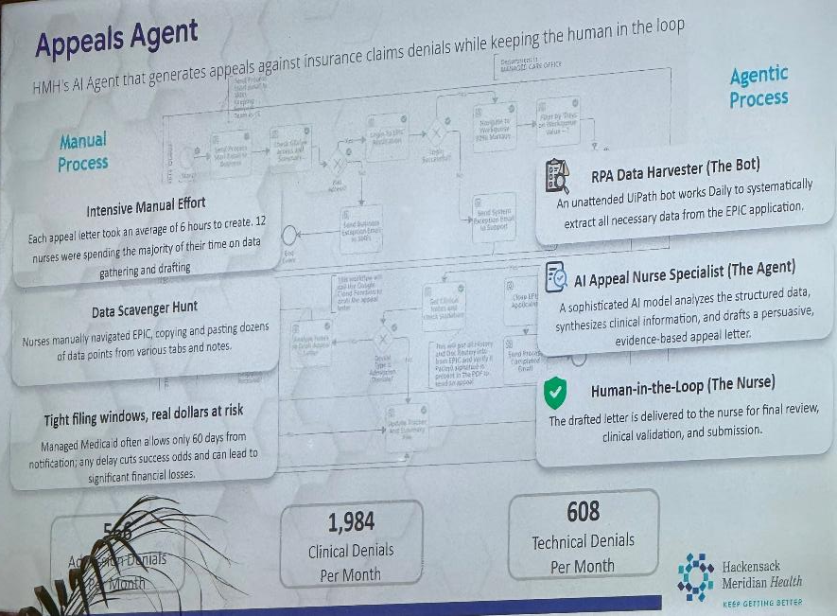
Agentic Applications for Healthcare Providers 3
Back to slide

Slide 24
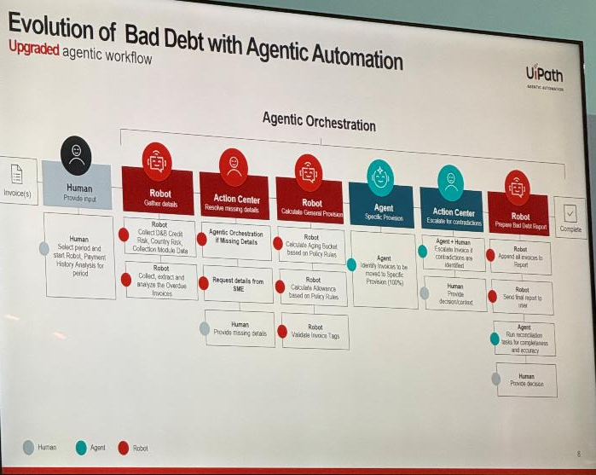
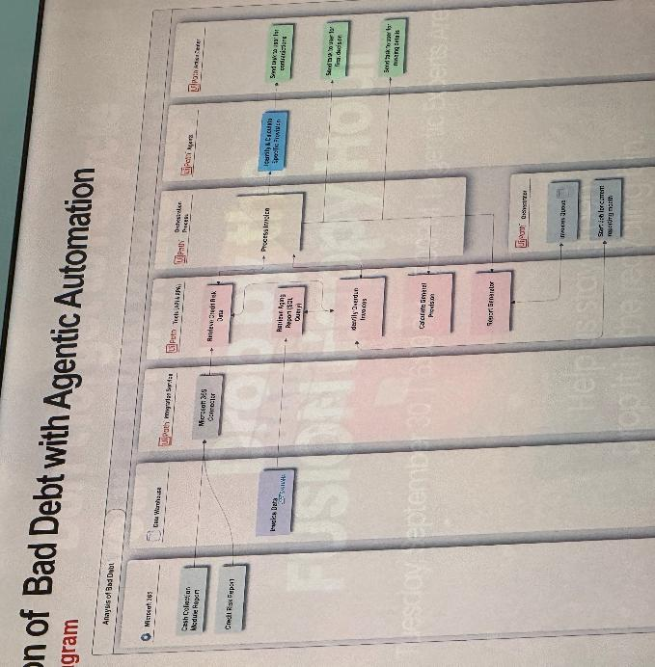
Agentic AI in Healthcare Finance – Photos 1
Back to Slide

Slide 25
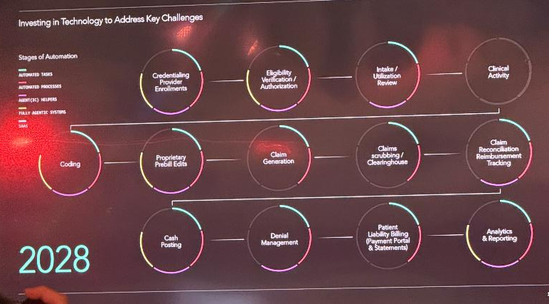
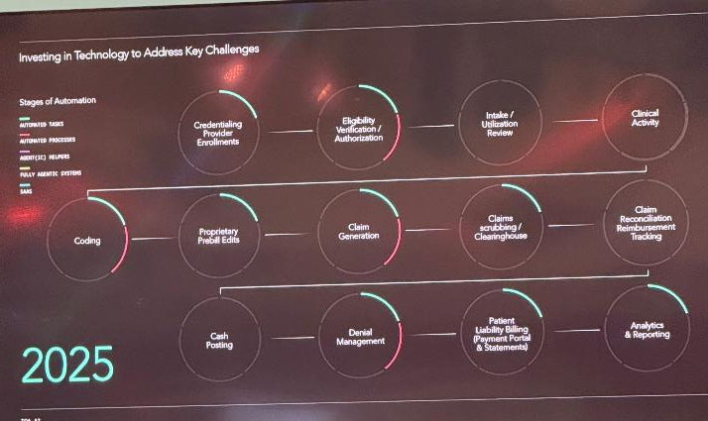
Agentic AI in Healthcare Finance – Photos 2
Back to Slide

Slide 26
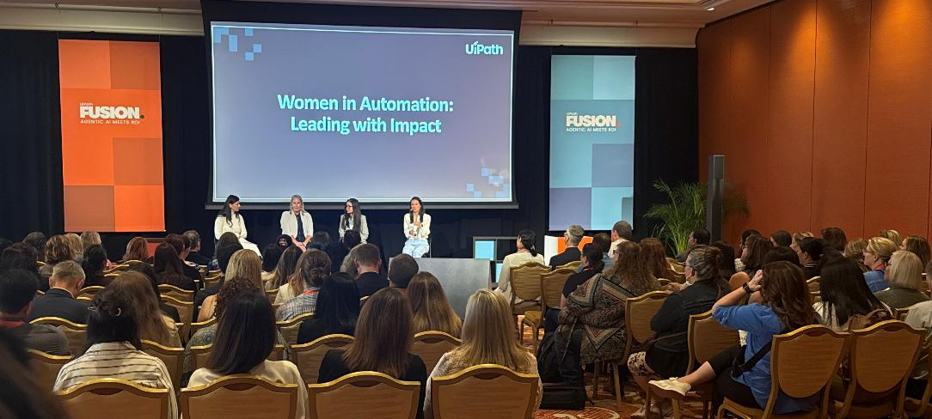
Photos – Phebe!
Back to Slide

Slide 27
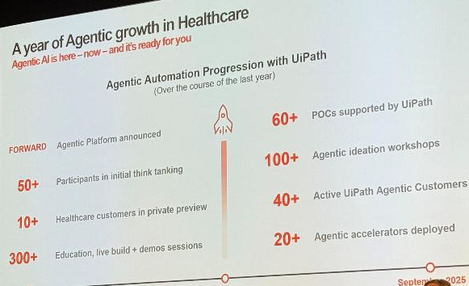
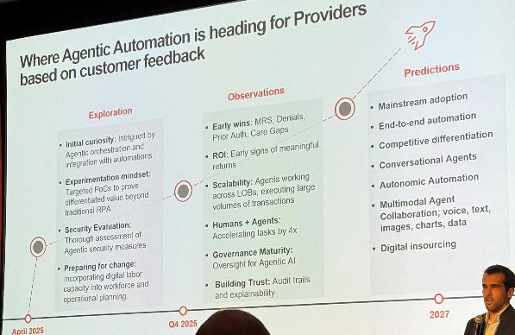
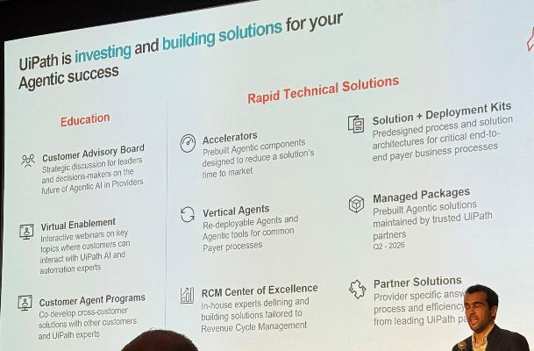
Provider Summit – Photos 1 – Kick off
Back to Slide

Slide 28
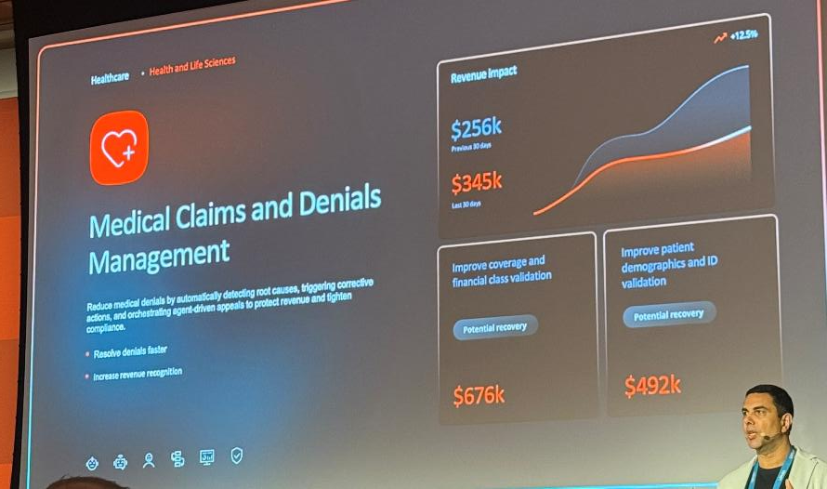
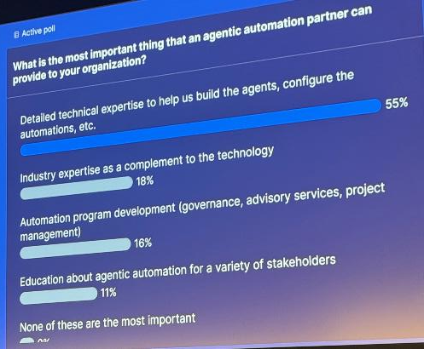
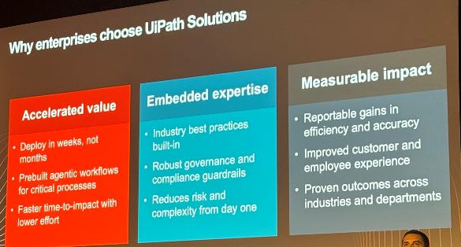
Provider Summit – Photos 2 – Denials Package
Back to Slide

Slide 29
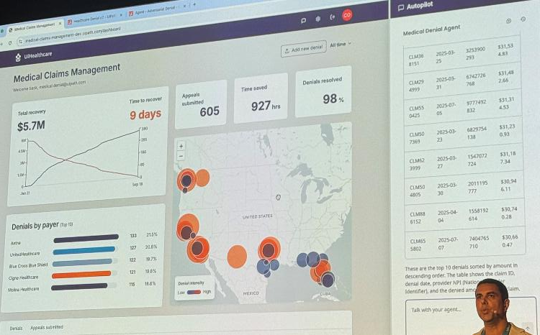
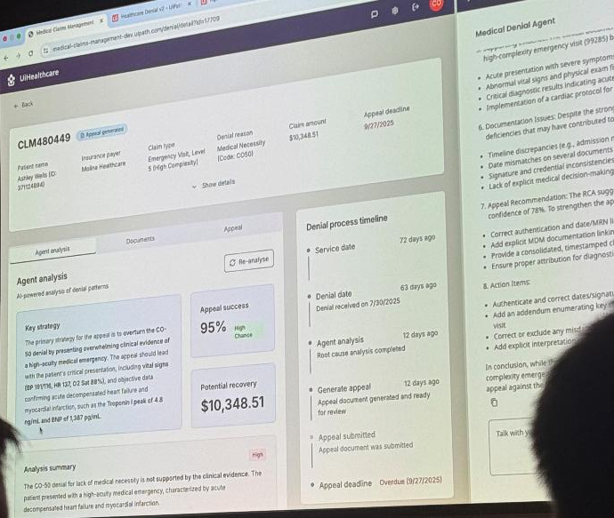
Provider Summit – Photos 3 – Denials Package
Back to Slide

Slide 30
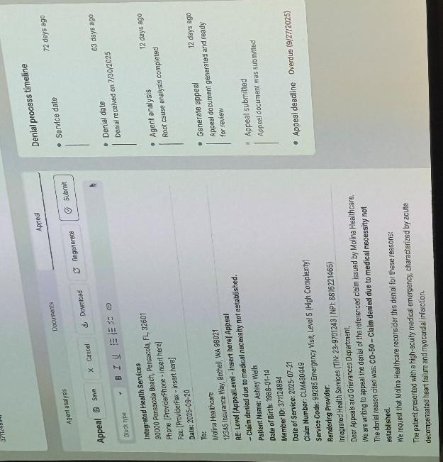
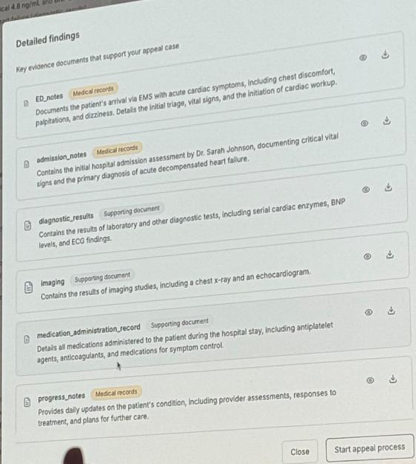
Provider Summit – Photos 4– Denials Package
Back to Slide

Slide 31
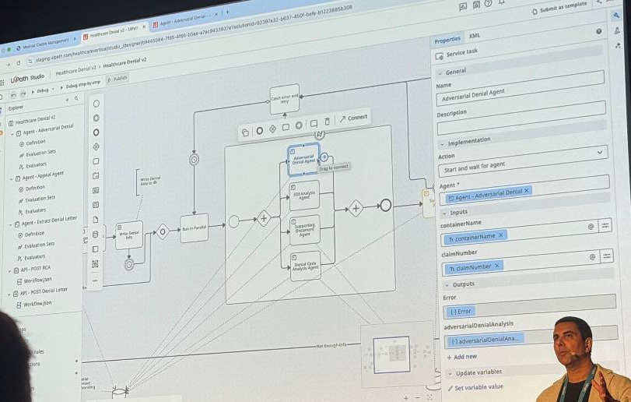
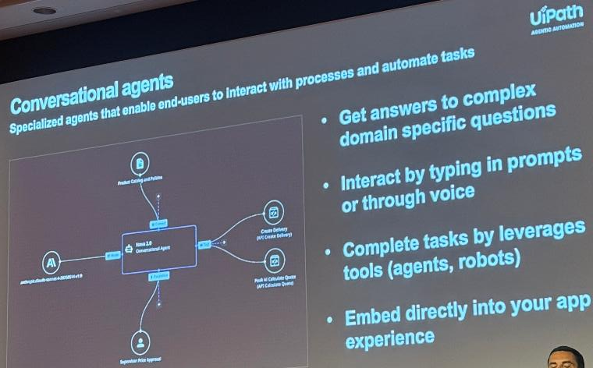
Provider Summit – Photos 5 – Denials Package
Back to Slide

Slide 32
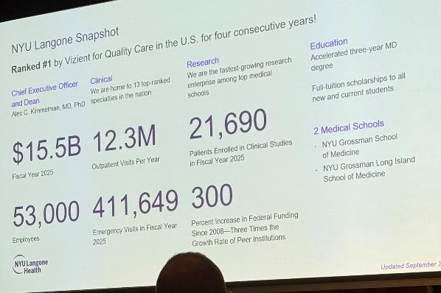
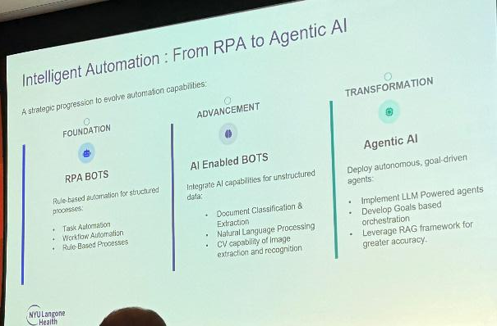
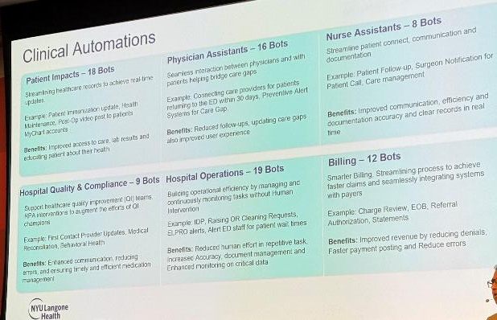
Provider Summit - NYU – Photos 1
Back to Slide

Slide 33
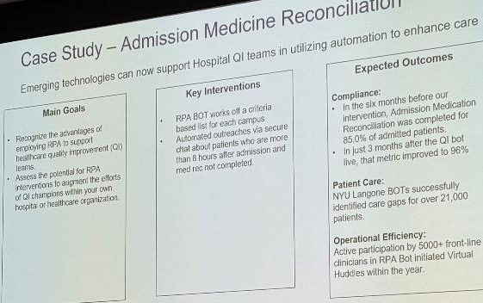
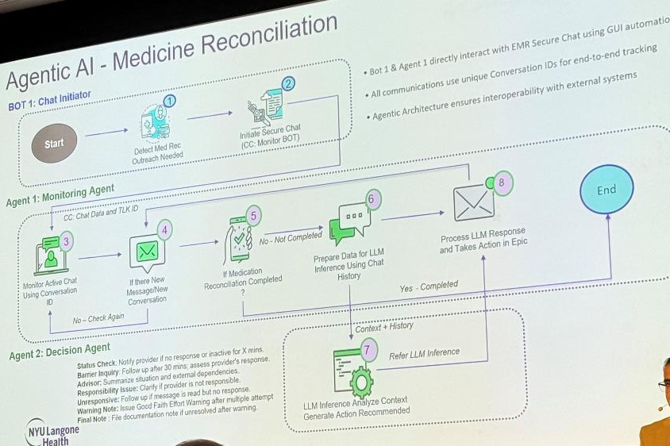
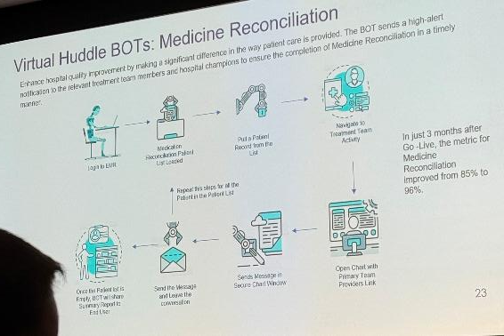
Provider Summit - NYU – Photos 2
Back to Slide

Slide 34
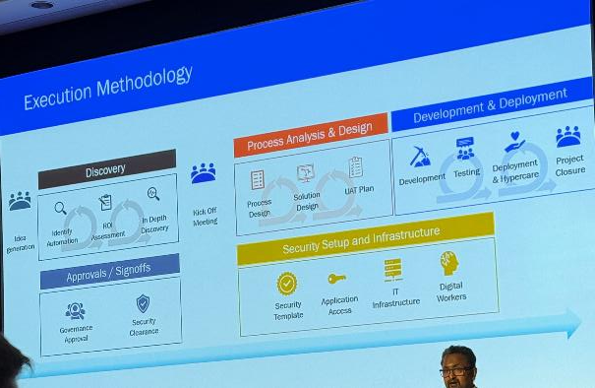
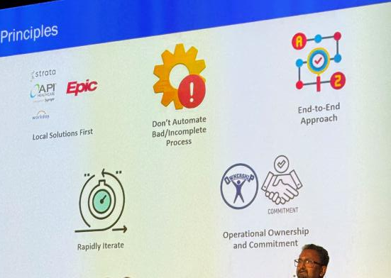
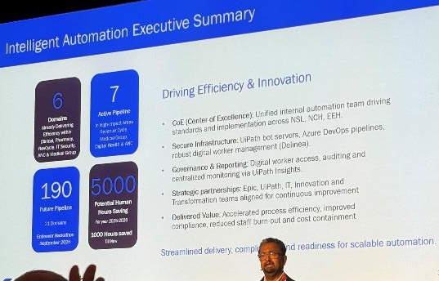
Provider Summit - Endeavor – Photos 1
Back to Slide

Slide 35
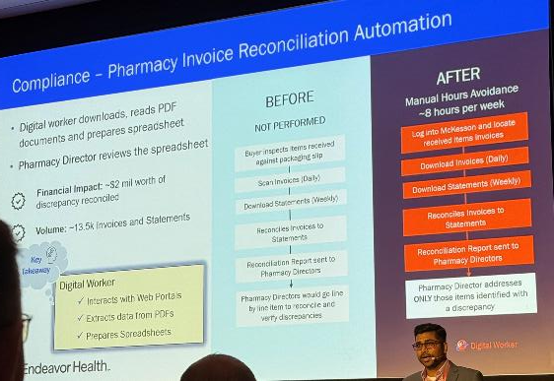
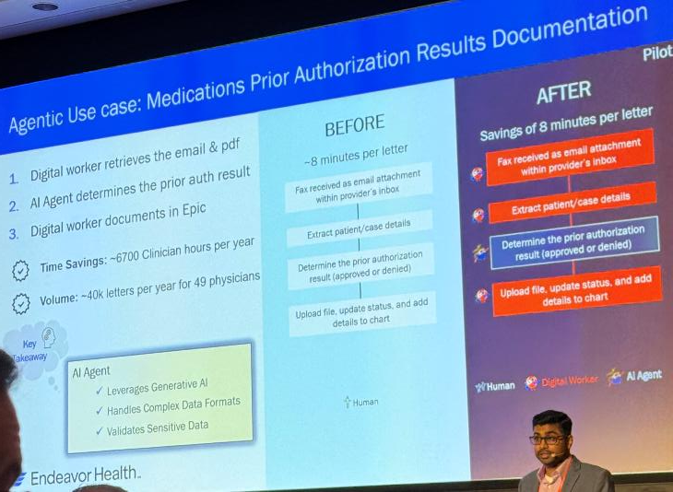
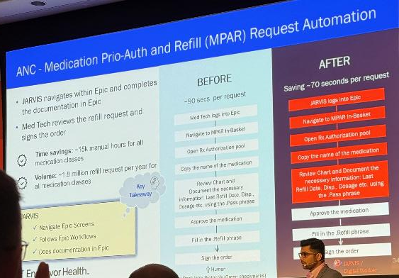
Provider Summit - Endeavor – Photos 2
Back to Slide

Slide 36
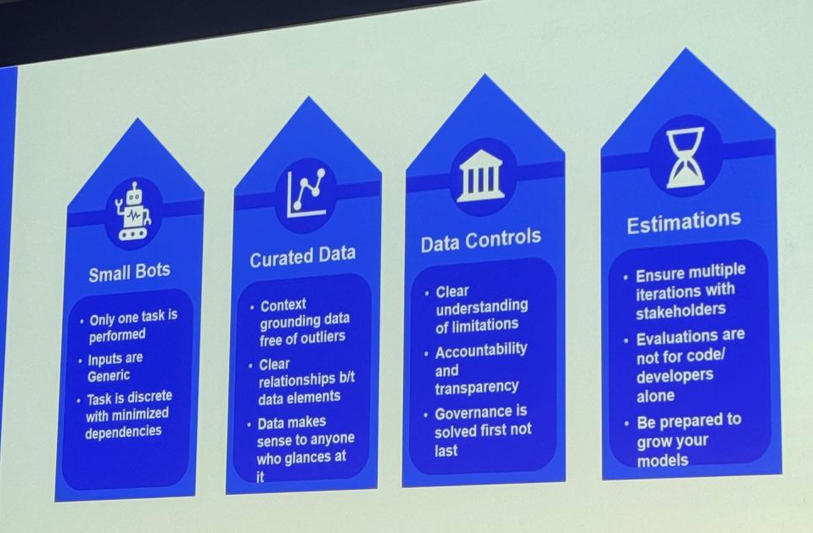
Provider Summit – VSP – Photos 1
Back to Slide

Slide 37


Provider Summit – VSP – Photos 2
Back to Slide

Slide 38



Provider Summit – VSP – Photos 3
Back to Slide

Slide 39


Provider Summit – OSF – Photos 1
Back to Slide

Slide 40



Provider Summit – OSF – Photos 2
Back to Slide

Slide 41

Provider Summit – OSF – Photos 3
Back to Slide

Slide 42


Surverys throughout Provider Summit

