Slide 2
Executive Education
Automation Technology

Slide 3
Agenda
Technology Definitions
What makes a good use case
Current applications

Slide 4
The Core Automation Technologies
The term “Automation” commonly refers to the following technologies.
ETL
Extract, Transform, Load
API
Application Programming Interface
RPA
Robotic Process Automation
These technologies are often ‘orchestrated’ via different software tools (e.g., Microsoft, UiPath) to automate a process.
OCR
Optical Character Recognition
LLM
Large Language Models
Agents
Agentic AI and Chat Bots
Apps
Low Code App Development

Slide 5
ETL defined
ETL
Extract Transform and Load (ETL) - is a data integration process used to combine data from multiple sources into a central repository. It involves extracting data, transforming it to conform to a unified schema, and then loading it into the target system for analysis and reporting.
Extract
Transform
Load
Pickup
Data Source 1
Transformation Engine
Target Location
Automation Platform
Data Source 2
ETL is commonly used to create lists of accounts to be worked by an automation
Notes:
Let’s watch a quick video of RPA in action. Here is a video from a SUNY professor automating the currency conversions of product sales using a leading automation platform vendor - UiPath.
I am purposefully using a non-healthcare example, to illustrate the basics of HOW RPA works. So don’t get distracted by the content - I know that you don’t do currency conversions in your job today.
You’ll notice that instead of a Call and Response framework, that an API uses, RPA is taking the same steps that you and I would take to complete the task. The bot is using google to find current exchange rates, copy those exchange rates and input them into a spreadsheet. Then within the spreadsheet the automation is running some analytics to covert the data entry. Lets take a look: Start video at 00:22 and end at 2:28 (Totally awesome).
Similar to APIs, there is a lot more complex tasks that RPA can do. But take a moment to reflect on all the times that you have to repeatedly move information from system to another. This is the bread and butter of RPA.
Now lets move on to some common terms that are associated with RPA.

Slide 6
ETL breakdown
ETL
Extract: This stage involves pulling data from various sources, which can include databases, files, APIs, or other systems. The extraction process can involve reading data, validating it, and potentially filtering out irrelevant information.
Transform: Once the data is extracted, it's transformed to ensure it's clean, consistent, and in a format suitable for the target system. Common transformation tasks include:
Data cleaning: Removing duplicates, handling missing values, and correcting errors.
Data conversion: Converting data types, formats, or values to match the schema of the target system.
Data joining: Combining data from multiple tables based on common fields.
Load: The final step involves loading the transformed data into the target system, which could be a data warehouse, data lake, or a folder.
Notes:
Let’s watch a quick video of RPA in action. Here is a video from a SUNY professor automating the currency conversions of product sales using a leading automation platform vendor - UiPath.
I am purposefully using a non-healthcare example, to illustrate the basics of HOW RPA works. So don’t get distracted by the content - I know that you don’t do currency conversions in your job today.
You’ll notice that instead of a Call and Response framework, that an API uses, RPA is taking the same steps that you and I would take to complete the task. The bot is using google to find current exchange rates, copy those exchange rates and input them into a spreadsheet. Then within the spreadsheet the automation is running some analytics to covert the data entry. Lets take a look: Start video at 00:22 and end at 2:28 (Totally awesome).
Similar to APIs, there is a lot more complex tasks that RPA can do. But take a moment to reflect on all the times that you have to repeatedly move information from system to another. This is the bread and butter of RPA.
Now lets move on to some common terms that are associated with RPA.

Slide 7
Why ETL is important?
ETL
Why is ETL important?
ETL is crucial for organizations that need to combine data from diverse sources for analysis, reporting, and business intelligence. By cleaning, transforming, and consolidating data, ETL enables businesses to gain a more comprehensive and accurate view of their operations, leading to better decision-making. It is commonly used to create a list of accounts that will be worked by an automation.
Example:
Imagine you want to automate a process that requires data from the EMR and a 3rd party vendor (e.g., Experian). ETL would be used to extract the data from both software systems, standardize, and then loaded into a database. That new data set would be used for analysis or as an input into a future automation.

Slide 8
API defined
API
Application Programming Interface (API) - are a set of instructions and protocols that allow one software application to interface with the functionalities or data of another application.
APIs deliver one application’s request to another and return a response in real time using a simple set of commands. An API call is the process of a client application submitting a request to a server's API and includes everything that happens after the request is submitted, including retrieving information from the server response.
1. Application makes a request
2. API takes the request to the Server
3. The Server executes the request
APIs work with a "Request" and "Response" framework
Application
API
Server
5. Application receives the requested information
4. API returns the information in the request
Notes:
Let’s watch a quick video of RPA in action. Here is a video from a SUNY professor automating the currency conversions of product sales using a leading automation platform vendor - UiPath.
I am purposefully using a non-healthcare example, to illustrate the basics of HOW RPA works. So don’t get distracted by the content - I know that you don’t do currency conversions in your job today.
You’ll notice that instead of a Call and Response framework, that an API uses, RPA is taking the same steps that you and I would take to complete the task. The bot is using google to find current exchange rates, copy those exchange rates and input them into a spreadsheet. Then within the spreadsheet the automation is running some analytics to covert the data entry. Lets take a look: Start video at 00:22 and end at 2:28 (Totally awesome).
Similar to APIs, there is a lot more complex tasks that RPA can do. But take a moment to reflect on all the times that you have to repeatedly move information from system to another. This is the bread and butter of RPA.
Now lets move on to some common terms that are associated with RPA.

Slide 9
API breakdown
API
Purpose of an API:
The purpose of an API is to allow an application to connect to a server indirectly. Rather than allowing an application to directly access a server, the organization will expose certain data elements via an API endpoint. This greatly enhances security and versatility. For example, multiple front-end applications (e.g., Web and mobile) can share the same back-end database. Organizations can make adjustments to back-end databases without impacting front-end applications or decide or expose new data with minimal effort.
Notes:
Let’s watch a quick video of RPA in action. Here is a video from a SUNY professor automating the currency conversions of product sales using a leading automation platform vendor - UiPath.
I am purposefully using a non-healthcare example, to illustrate the basics of HOW RPA works. So don’t get distracted by the content - I know that you don’t do currency conversions in your job today.
You’ll notice that instead of a Call and Response framework, that an API uses, RPA is taking the same steps that you and I would take to complete the task. The bot is using google to find current exchange rates, copy those exchange rates and input them into a spreadsheet. Then within the spreadsheet the automation is running some analytics to covert the data entry. Lets take a look: Start video at 00:22 and end at 2:28 (Totally awesome).
Similar to APIs, there is a lot more complex tasks that RPA can do. But take a moment to reflect on all the times that you have to repeatedly move information from system to another. This is the bread and butter of RPA.
Now lets move on to some common terms that are associated with RPA.

Slide 10
Why are APIs important?
API
APIs are the backbone of traditional software. They are the fastest and most-stable way to move data across software systems. Unfortunately, software in the healthcare ecosystem commonly lacks APIs.
Area | API
General purpose | APIs enable the integration and communication between different software systems to achieve broader automation and data exchange goals. Widely used in software development, web services, and cloud computing, with broad applications.
Integration | Facilitates interoperability between different software components and services through a standardized set of protocols you never see.
Stability | APIs are very stable connections (more stable than RPA)
Speed | Facilitates real-time data retrieval, enabling faster information exchange between applications.
Note: APIs are always preferred to RPA due to their stability, speed, and low maintenance requirements.
Notes:
Let’s watch a quick video of RPA in action. Here is a video from a SUNY professor automating the currency conversions of product sales using a leading automation platform vendor - UiPath.
I am purposefully using a non-healthcare example, to illustrate the basics of HOW RPA works. So don’t get distracted by the content - I know that you don’t do currency conversions in your job today.
You’ll notice that instead of a Call and Response framework, that an API uses, RPA is taking the same steps that you and I would take to complete the task. The bot is using google to find current exchange rates, copy those exchange rates and input them into a spreadsheet. Then within the spreadsheet the automation is running some analytics to covert the data entry. Lets take a look: Start video at 00:22 and end at 2:28 (Totally awesome).
Similar to APIs, there is a lot more complex tasks that RPA can do. But take a moment to reflect on all the times that you have to repeatedly move information from system to another. This is the bread and butter of RPA.
Now lets move on to some common terms that are associated with RPA.

Slide 11

API Example
If you’re using the internet or a smartphone, you’ve used an API.
Example:
APIs enhance the functionality of a travel website by facilitating the communication with external services. By integrating with airline or hotel APIs, travel websites (such as KAYAK) provide users with real-time and accurate information on flight schedules, seat availability, and hotel options.
These APIs act as bridges, connecting the website directly to the respective databases and reservation systems, enabling users to access a comprehensive range of travel services. The API's role as a mediator ensures that the website can dynamically retrieve and present up-to-date data from various external sources.

Slide 12
RPA defined
Expertise
RPA
Robotic Process Automation (RPA) - is a technology that uses software robots or "bots" to automate repetitive and rule-based tasks within business processes. It mimics human actions (robotic) by following a prescriptive set of steps to achieve a desired outcome (process) without human intervention (automation) by using the graphical user interface (the part of software you and I interact with).
Just like humans, software robots can understand what’s on a screen, complete the right keystrokes, navigate systems, and identify and extract data.

Slide 13
RPA breakdown
Expertise
RPA
The key element that makes RPA unique and flexible is its ability to use the Graphical User Interface. The following techniques are what makes this possible.
Selectors: RPA uses selectors to precisely locate and interact with elements on a web page or application, enabling the automation of various tasks. Selectors are unique addresses for each element.
Computer vision: RPA software is trained to recognize a distinct image (down to the pixel level) and make decisions based on that image for navigation and decision making.
Screen scraping: Capturing data present on the screen of a web page or application for use other system. It is used across many industries and deployed when other means of gathering data are not available, such as an API.
Key strokes: RPA can code common keystrokes, mouse clicks, macros to navigate web pages or applications the same way a human completes the same task. These shortcuts are standard within web browsers or applications.

Slide 14
Why RPA is important
RPA
RPA's main strength is pulling any data element exposed to an end-user (i.e., through a graphical user interface).
Area | RPA
General purpose | RPA can be used to automate specific tasks and business process. Great for rule-based tasks. Suitable for a wide range of tasks and industries, especially those involving data entry and manipulation.
Integration | Uses a software systems graphical user interface - the same part of the software that is designed for an end user.
Stability | Less stable. Bots must be rebuilt every time a web-page or software is changed or upgraded.
Speed | Executes tasks quickly and consistently without fatigue or errors.
Learning curve | Easier to learn, don’t need developer skills to begin.
Notes:
Now that we’ve defined automation and seen the technologies in action, lets break down the comparison between RPA and APIs one more time.
General purpose and Integration: RPA can be used to automation specific tasks and processes. It does so by using the graphical user interface - which is the part of the software that you and I use. Its used across all industries and widely used for data entry, manipulation, and movement.
APIs on the other hand enable integration and communication between different software systems. APIs are really the backbone of the web and most software. Its what allows applications to automatically update. APIs use standard protocols that you never see or use (Unless you’re a developer).
Stability: APIs are more stable than RPA. RPA must be re-built every time there is a change to the graphical user interface. API exchange protocols are updated less often.
Speed: Both are faster than a human, but APIs are faster than RPA because there is less overall navigation.
Learning curve. RPA is easier to learn than APIs. Generally speaking the creation and connection with APIs requires a traditional educational background in software engineering.
Hope that you have a clear understanding of what we mean when we use the term automation. This concludes the content for this module. Thanks for watching!

Slide 15
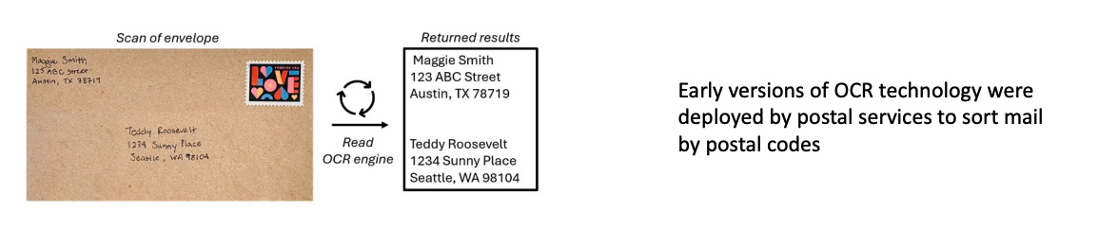
OCR Defined
OCR
Optical Character Recognition (OCR) - Optical character recognition is the electronic conversion of images of typed, handwritten, or printed text into machine-encoded text. It is a field of research in pattern recognition, artificial intelligence and computer vision.
OCR is widely used as a form of data entry from printed paper data records such as paper correspondence, invoices, orders, or any suitable documentation. It is a common method of digitizing printed texts so that they can be electronically edited, searched, and used in automated processes.
Notes:
Now that you’ve seen RPA in action, there are a few terms that you should be comfortable with as they are often used when discussing RPA.
Selectors. RPA will use selectors to precisely locate different elements on a web-page. Think of a selector a unique address for an element or widget that is displayed on a webpage. (Right click and hit ‘Inspect’ on any web-page).
Screen scraping. Screen scraping is simply the software robot copy things from a webpage. One of the major benefits of RPA is that it can scrape anything from a website.
Key stokes. If you’ve ever navigated a spreadsheet or a webpage without a mouse, you’ve used keystrokes. RPA can use predefined keystrokes, for example hitting tab or enter, to isolate navigate webpages or software.
Image recognition. In essence you can train the robot to recognize a certain image on a page. By recognizing the image, the software robot can interact with it. There has been a lot of improvement in this space to recognize the shape, color, and position of elements of a web-page.
All of these things are common techniques deployed by RPA developers.

Slide 16
OCR Breakdown
OCR
OCR works best on document types that don't vary. The more variation the harder it is to build models/processes to classify and extract.
Inflow
Digitize
Classify
Extract
Outflow
Data Source (e.g. PDF, etc.)
Make document machine readable
Classify Documents for Extraction
Pull out data from 'in scope' documents
Use extracted data as needed
Train and validate
Most OCR workflows require machine learning models and humans to validate the classification and extraction of text from scanned images. In healthcare, a common workflow might involve sorting through paper correspondence notices from insurance companies and then extracting data elements based on the payer (such as denial reasons).
Notes:
Now that you’ve seen RPA in action, there are a few terms that you should be comfortable with as they are often used when discussing RPA.
Selectors. RPA will use selectors to precisely locate different elements on a web-page. Think of a selector a unique address for an element or widget that is displayed on a webpage. (Right click and hit ‘Inspect’ on any web-page).
Screen scraping. Screen scraping is simply the software robot copy things from a webpage. One of the major benefits of RPA is that it can scrape anything from a website.
Key stokes. If you’ve ever navigated a spreadsheet or a webpage without a mouse, you’ve used keystrokes. RPA can use predefined keystrokes, for example hitting tab or enter, to isolate navigate webpages or software.
Image recognition. In essence you can train the robot to recognize a certain image on a page. By recognizing the image, the software robot can interact with it. There has been a lot of improvement in this space to recognize the shape, color, and position of elements of a web-page.
All of these things are common techniques deployed by RPA developers.

Slide 17
Why is OCR Important
OCR
Improved Efficiency:
OCR eliminates the time-consuming process of manually transcribing information from paper records into electronic formats. This provides access to information more rapidly, saving valuable time and resources.
Enhanced Data Accuracy:
OCR reduces human error associated with manual data entry, which can lead to inaccurate records. By ensuring consistent data extraction across various documents, OCR maintains the integrity of records.
Cost Savings:
OCR reduces the need for manual data entry, which saves on labor costs. By streamlining workflows and reducing errors, OCR contributes to cost-effective operations.
Top of License:
OCR can eliminate low cognitive work which allows staff to work at the "top of their license".
Notes:
Now that you’ve seen RPA in action, there are a few terms that you should be comfortable with as they are often used when discussing RPA.
Selectors. RPA will use selectors to precisely locate different elements on a web-page. Think of a selector a unique address for an element or widget that is displayed on a webpage. (Right click and hit ‘Inspect’ on any web-page).
Screen scraping. Screen scraping is simply the software robot copy things from a webpage. One of the major benefits of RPA is that it can scrape anything from a website.
Key stokes. If you’ve ever navigated a spreadsheet or a webpage without a mouse, you’ve used keystrokes. RPA can use predefined keystrokes, for example hitting tab or enter, to isolate navigate webpages or software.
Image recognition. In essence you can train the robot to recognize a certain image on a page. By recognizing the image, the software robot can interact with it. There has been a lot of improvement in this space to recognize the shape, color, and position of elements of a web-page.
All of these things are common techniques deployed by RPA developers.

Slide 18
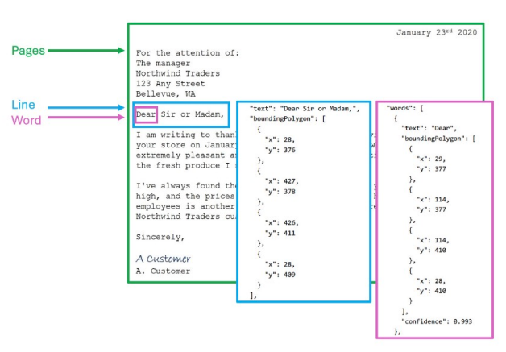
OCR Example
OCR
Common Healthcare Examples:
Remittance Advice
Order Intake
Medical Forms
Medical Bills
Health Records
Claim Processing
Provider Bill Processing
Medical Records
Remember, the more standardized the document type, the better!
OCR engines work by taking in a file and identifying bounding boxes / coordinates based on the location on the image. Each line and word includes bounding box coordinates indicating its position on the page. Developers can use the Lines and Words to extract and use the data they need for the automation.
Notes:
Now that you’ve seen RPA in action, there are a few terms that you should be comfortable with as they are often used when discussing RPA.
Selectors. RPA will use selectors to precisely locate different elements on a web-page. Think of a selector a unique address for an element or widget that is displayed on a webpage. (Right click and hit ‘Inspect’ on any web-page).
Screen scraping. Screen scraping is simply the software robot copy things from a webpage. One of the major benefits of RPA is that it can scrape anything from a website.
Key stokes. If you’ve ever navigated a spreadsheet or a webpage without a mouse, you’ve used keystrokes. RPA can use predefined keystrokes, for example hitting tab or enter, to isolate navigate webpages or software.
Image recognition. In essence you can train the robot to recognize a certain image on a page. By recognizing the image, the software robot can interact with it. There has been a lot of improvement in this space to recognize the shape, color, and position of elements of a web-page.
All of these things are common techniques deployed by RPA developers.

Slide 19
LLM Defined
LLM
Large Language Models (LLM) - A LLM is a type of artificial intelligence that can generate human-like text and perform various language-related tasks. They are trained on massive datasets of text and code, enabling them to learn patterns and relationships between words, phrases and sentences, similar to how humans learn through exposure to language.
LLMs do not understand the meaning of language. It is prediction - a simulation of human language.
Large Language models can perform a wide set of tasks, including:
Generate natural language and code completion based on natural language prompts
Create original images from natural language
Transcribe and translate speech to text
Synthesize text to speech
Notes:
Now that you’ve seen RPA in action, there are a few terms that you should be comfortable with as they are often used when discussing RPA.
Selectors. RPA will use selectors to precisely locate different elements on a web-page. Think of a selector a unique address for an element or widget that is displayed on a webpage. (Right click and hit ‘Inspect’ on any web-page).
Screen scraping. Screen scraping is simply the software robot copy things from a webpage. One of the major benefits of RPA is that it can scrape anything from a website.
Key stokes. If you’ve ever navigated a spreadsheet or a webpage without a mouse, you’ve used keystrokes. RPA can use predefined keystrokes, for example hitting tab or enter, to isolate navigate webpages or software.
Image recognition. In essence you can train the robot to recognize a certain image on a page. By recognizing the image, the software robot can interact with it. There has been a lot of improvement in this space to recognize the shape, color, and position of elements of a web-page.
All of these things are common techniques deployed by RPA developers.

Slide 20
LLM Breakdown
LLM
LLMs use a ‘transformer’ architecture, enabling them to represent semantic relationships between words and use those words to determine probable sequences of text.
Let’s use an example based on translating a prompt from English to Spanish:
Input or Prompt
Encoder
Fixed-length representation
Decoder
Output
“I love cats”
The Encoder processes the input sequence to create a “fixed-length representation”.
A fixed length representation is a numerical representation of the input that captures semantic meaning, context, and relevant information.
The Decoder takes the fixed-length representation and uses it to generate the output sequence (e.g., translated text).
The prediction is based on both the current fixed-length representation and the previously generated sequences.
Spanish translation:
“Amo a los gatos”
This is the ”Secret Sauce”. LLMs break down language into mathematical predictions that can reference itself.
Notes:
Now that you’ve seen RPA in action, there are a few terms that you should be comfortable with as they are often used when discussing RPA.
Selectors. RPA will use selectors to precisely locate different elements on a web-page. Think of a selector a unique address for an element or widget that is displayed on a webpage. (Right click and hit ‘Inspect’ on any web-page).
Screen scraping. Screen scraping is simply the software robot copy things from a webpage. One of the major benefits of RPA is that it can scrape anything from a website.
Key stokes. If you’ve ever navigated a spreadsheet or a webpage without a mouse, you’ve used keystrokes. RPA can use predefined keystrokes, for example hitting tab or enter, to isolate navigate webpages or software.
Image recognition. In essence you can train the robot to recognize a certain image on a page. By recognizing the image, the software robot can interact with it. There has been a lot of improvement in this space to recognize the shape, color, and position of elements of a web-page.
All of these things are common techniques deployed by RPA developers.

Slide 21
Why are LLMs Important
LLM
LLMs have enabled computers to understand and generate human-like functions. Their ability to process and analyze vast amounts of data makes them powerful tools for tasks ranging from simple translation to complex code generation and even aiding in scientific research.
Enhanced Communication:
LLMs form the foundation for chatbots and virtual assistants, enabling more natural and engaging interactions
LLMs facilitate seamless communication across different languages
Efficiency:
LLMs can automate tasks like data entry, synthesizing, content generation to free staff up for more strategic work
LLMs assist developers by generating code or queries based on natural language descriptions
Foundation for AI Applications:
LLMs serve as the basis for various technologies including virtual assistants (Co-Pilots), search, etc.
LLMs can be built into automated workflows bringing tasks to tackle challenges that were not previously possible, such as writing an appeal letter or interpreting a payer policy.
Notes:
Now that you’ve seen RPA in action, there are a few terms that you should be comfortable with as they are often used when discussing RPA.
Selectors. RPA will use selectors to precisely locate different elements on a web-page. Think of a selector a unique address for an element or widget that is displayed on a webpage. (Right click and hit ‘Inspect’ on any web-page).
Screen scraping. Screen scraping is simply the software robot copy things from a webpage. One of the major benefits of RPA is that it can scrape anything from a website.
Key stokes. If you’ve ever navigated a spreadsheet or a webpage without a mouse, you’ve used keystrokes. RPA can use predefined keystrokes, for example hitting tab or enter, to isolate navigate webpages or software.
Image recognition. In essence you can train the robot to recognize a certain image on a page. By recognizing the image, the software robot can interact with it. There has been a lot of improvement in this space to recognize the shape, color, and position of elements of a web-page.
All of these things are common techniques deployed by RPA developers.

Slide 22
LLM Example
LLM
Many organizations are interested in using LLMs to understand clinical policies and medical records, and write appeals.
Payer Denial
Review the clinical policy
Review the medical record
Write appeal
Submit appeal to the payer
Before LLMs these tasks could only be performed by a human.
Notes:
Now that you’ve seen RPA in action, there are a few terms that you should be comfortable with as they are often used when discussing RPA.
Selectors. RPA will use selectors to precisely locate different elements on a web-page. Think of a selector a unique address for an element or widget that is displayed on a webpage. (Right click and hit ‘Inspect’ on any web-page).
Screen scraping. Screen scraping is simply the software robot copy things from a webpage. One of the major benefits of RPA is that it can scrape anything from a website.
Key stokes. If you’ve ever navigated a spreadsheet or a webpage without a mouse, you’ve used keystrokes. RPA can use predefined keystrokes, for example hitting tab or enter, to isolate navigate webpages or software.
Image recognition. In essence you can train the robot to recognize a certain image on a page. By recognizing the image, the software robot can interact with it. There has been a lot of improvement in this space to recognize the shape, color, and position of elements of a web-page.
All of these things are common techniques deployed by RPA developers.

Slide 23
Agentic AI
Agents
The latest industry trend is combining many of the tools we previously discussed.
Agentic AI (“Agents”) – Refers to AI systems (powered by LLMs and other technologies) that can act autonomously, making decisions and taking actions to achieve specific goals with decreasing human supervision. Unlike ‘traditional AI’ that would rely on predefined instructions, Agents exhibit a level of autonomy, goal-driven behavior, and adaptability.
Agents are probabilistic. They rely on patterns and probabilities to changing environments and events. This is differentiated from other technologies, like RPA, that are rule-based or deterministic.
Tarpon believes that while Agents can address challenges beyond the scope of deterministic tools like RPA, healthcare workflows must adhere to strict compliance. We envision a future where workflows combine both technologies, with humans in the loop for probabilistic tasks.
Notes:
Now that you’ve seen RPA in action, there are a few terms that you should be comfortable with as they are often used when discussing RPA.
Selectors. RPA will use selectors to precisely locate different elements on a web-page. Think of a selector a unique address for an element or widget that is displayed on a webpage. (Right click and hit ‘Inspect’ on any web-page).
Screen scraping. Screen scraping is simply the software robot copy things from a webpage. One of the major benefits of RPA is that it can scrape anything from a website.
Key stokes. If you’ve ever navigated a spreadsheet or a webpage without a mouse, you’ve used keystrokes. RPA can use predefined keystrokes, for example hitting tab or enter, to isolate navigate webpages or software.
Image recognition. In essence you can train the robot to recognize a certain image on a page. By recognizing the image, the software robot can interact with it. There has been a lot of improvement in this space to recognize the shape, color, and position of elements of a web-page.
All of these things are common techniques deployed by RPA developers.

Slide 24


Copilot
Agents
Microsoft named their AI-powered assistant “Copilot”. Copilots can be built and configured to help users with various tasks. Copilot studio allows organizations to build their own agents that can be integrated into various workflows.
Copilot
What it is:
AI-powered assistants embedded in Microsoft 365 apps (e.g., Word, Excel, Teams, Outlook).
What it does:
Summarizes emails, drafts documents, analyzes data, etc.
Designed to assist individual users in real time
Example:
Copilot in Teams summarizes meetings; Copilot in Outlook drafts patient referral emails.
Copilot Studio
What it is:
A platform to build, customize, and manage your own AI agents, workflows, and copilots.
What it does:
Enables creation of custom Copilots and agents
Uses a no-code/low-code interface
Example:
Build a virtual agent that helps staff complete prior authorizations or manage appointment requests.
Notes:
Now that you’ve seen RPA in action, there are a few terms that you should be comfortable with as they are often used when discussing RPA.
Selectors. RPA will use selectors to precisely locate different elements on a web-page. Think of a selector a unique address for an element or widget that is displayed on a webpage. (Right click and hit ‘Inspect’ on any web-page).
Screen scraping. Screen scraping is simply the software robot copy things from a webpage. One of the major benefits of RPA is that it can scrape anything from a website.
Key stokes. If you’ve ever navigated a spreadsheet or a webpage without a mouse, you’ve used keystrokes. RPA can use predefined keystrokes, for example hitting tab or enter, to isolate navigate webpages or software.
Image recognition. In essence you can train the robot to recognize a certain image on a page. By recognizing the image, the software robot can interact with it. There has been a lot of improvement in this space to recognize the shape, color, and position of elements of a web-page.
All of these things are common techniques deployed by RPA developers.

Slide 25

Agentic Automation
Agents
On April 30th 2025, UiPath released a major product update as a part of their ongoing efforts to transition from traditional RPA to intelligent automation.
Agentic Automation is UiPath’s vision of creating autonomous digital agents — bots that can reason, learn, plan, and take proactive action based on dynamic goals and environments.
Think of it as giving your bots a sense of “agency” — the ability to figure out how to achieve a goal, not just what steps to follow.
Why it matters:
Developers will now be able to develop using UiPath’s new tools. Simply, this means that developers can now build “Agents” that:
Accept tasks in plain language
Decide how to approach those tasks
Leverage various automations, APIs, and tools to complete them
Read more here.

Slide 26
Apps
Apps
Design visually appealing professional apps using a web interface with easy drag and drop controls
UiPath Apps (“Apps”) – UiPath Apps is a cloud based low-code application development platform that enables you to build and share enterprise grade custom applications that deliver engaging user experiences. Using UiPath Apps, you can quickly build custom business applications that connect to data in any underlying cloud or on premises system using the power of automation.
Why build an App?
Lower cost and complexity than traditional software development
Apps can connect to your organization's data (in the cloud or on premise) with systems that don't have APIs or database access
Enterprise grade and customizable to your workflows
Centrally govern with the UiPath platform
.
Notes:
Now that you’ve seen RPA in action, there are a few terms that you should be comfortable with as they are often used when discussing RPA.
Selectors. RPA will use selectors to precisely locate different elements on a web-page. Think of a selector a unique address for an element or widget that is displayed on a webpage. (Right click and hit ‘Inspect’ on any web-page).
Screen scraping. Screen scraping is simply the software robot copy things from a webpage. One of the major benefits of RPA is that it can scrape anything from a website.
Key stokes. If you’ve ever navigated a spreadsheet or a webpage without a mouse, you’ve used keystrokes. RPA can use predefined keystrokes, for example hitting tab or enter, to isolate navigate webpages or software.
Image recognition. In essence you can train the robot to recognize a certain image on a page. By recognizing the image, the software robot can interact with it. There has been a lot of improvement in this space to recognize the shape, color, and position of elements of a web-page.
All of these things are common techniques deployed by RPA developers.

Slide 27
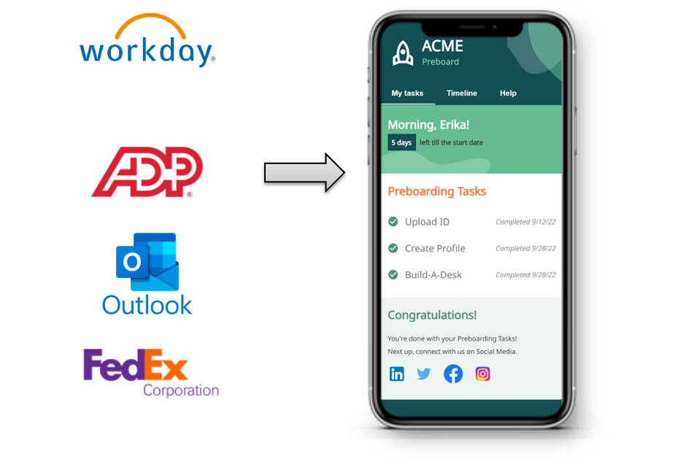
App Examples
Apps
Imagine streamlining the employee onboarding experience
What if everything you needed for onboarding, was in one streamlined, automated view?
For example:
Shipping info for your laptop and phone
Guidance on which Team's channels to join
A list of who to set up 1:1’s with
Payroll instructions
Notes:
Now that you’ve seen RPA in action, there are a few terms that you should be comfortable with as they are often used when discussing RPA.
Selectors. RPA will use selectors to precisely locate different elements on a web-page. Think of a selector a unique address for an element or widget that is displayed on a webpage. (Right click and hit ‘Inspect’ on any web-page).
Screen scraping. Screen scraping is simply the software robot copy things from a webpage. One of the major benefits of RPA is that it can scrape anything from a website.
Key stokes. If you’ve ever navigated a spreadsheet or a webpage without a mouse, you’ve used keystrokes. RPA can use predefined keystrokes, for example hitting tab or enter, to isolate navigate webpages or software.
Image recognition. In essence you can train the robot to recognize a certain image on a page. By recognizing the image, the software robot can interact with it. There has been a lot of improvement in this space to recognize the shape, color, and position of elements of a web-page.
All of these things are common techniques deployed by RPA developers.

